Slide 1


Diocese of Western North Carolina
COVID-19 Financial Assistance
April 8, 2020

Slide 2


Agenda
Introduction to Diocesan COVID-19 Finance Team
Choosing your path
  CPG Waiver and Deferrals
  Families First Coronavirus Response Act (FFRCA)
  Coronavirus Aid, Relief, and Economic Security Act (CARES)
References
Next Steps

Slide 3
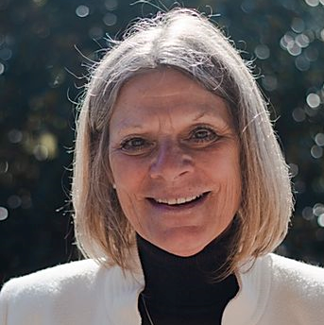
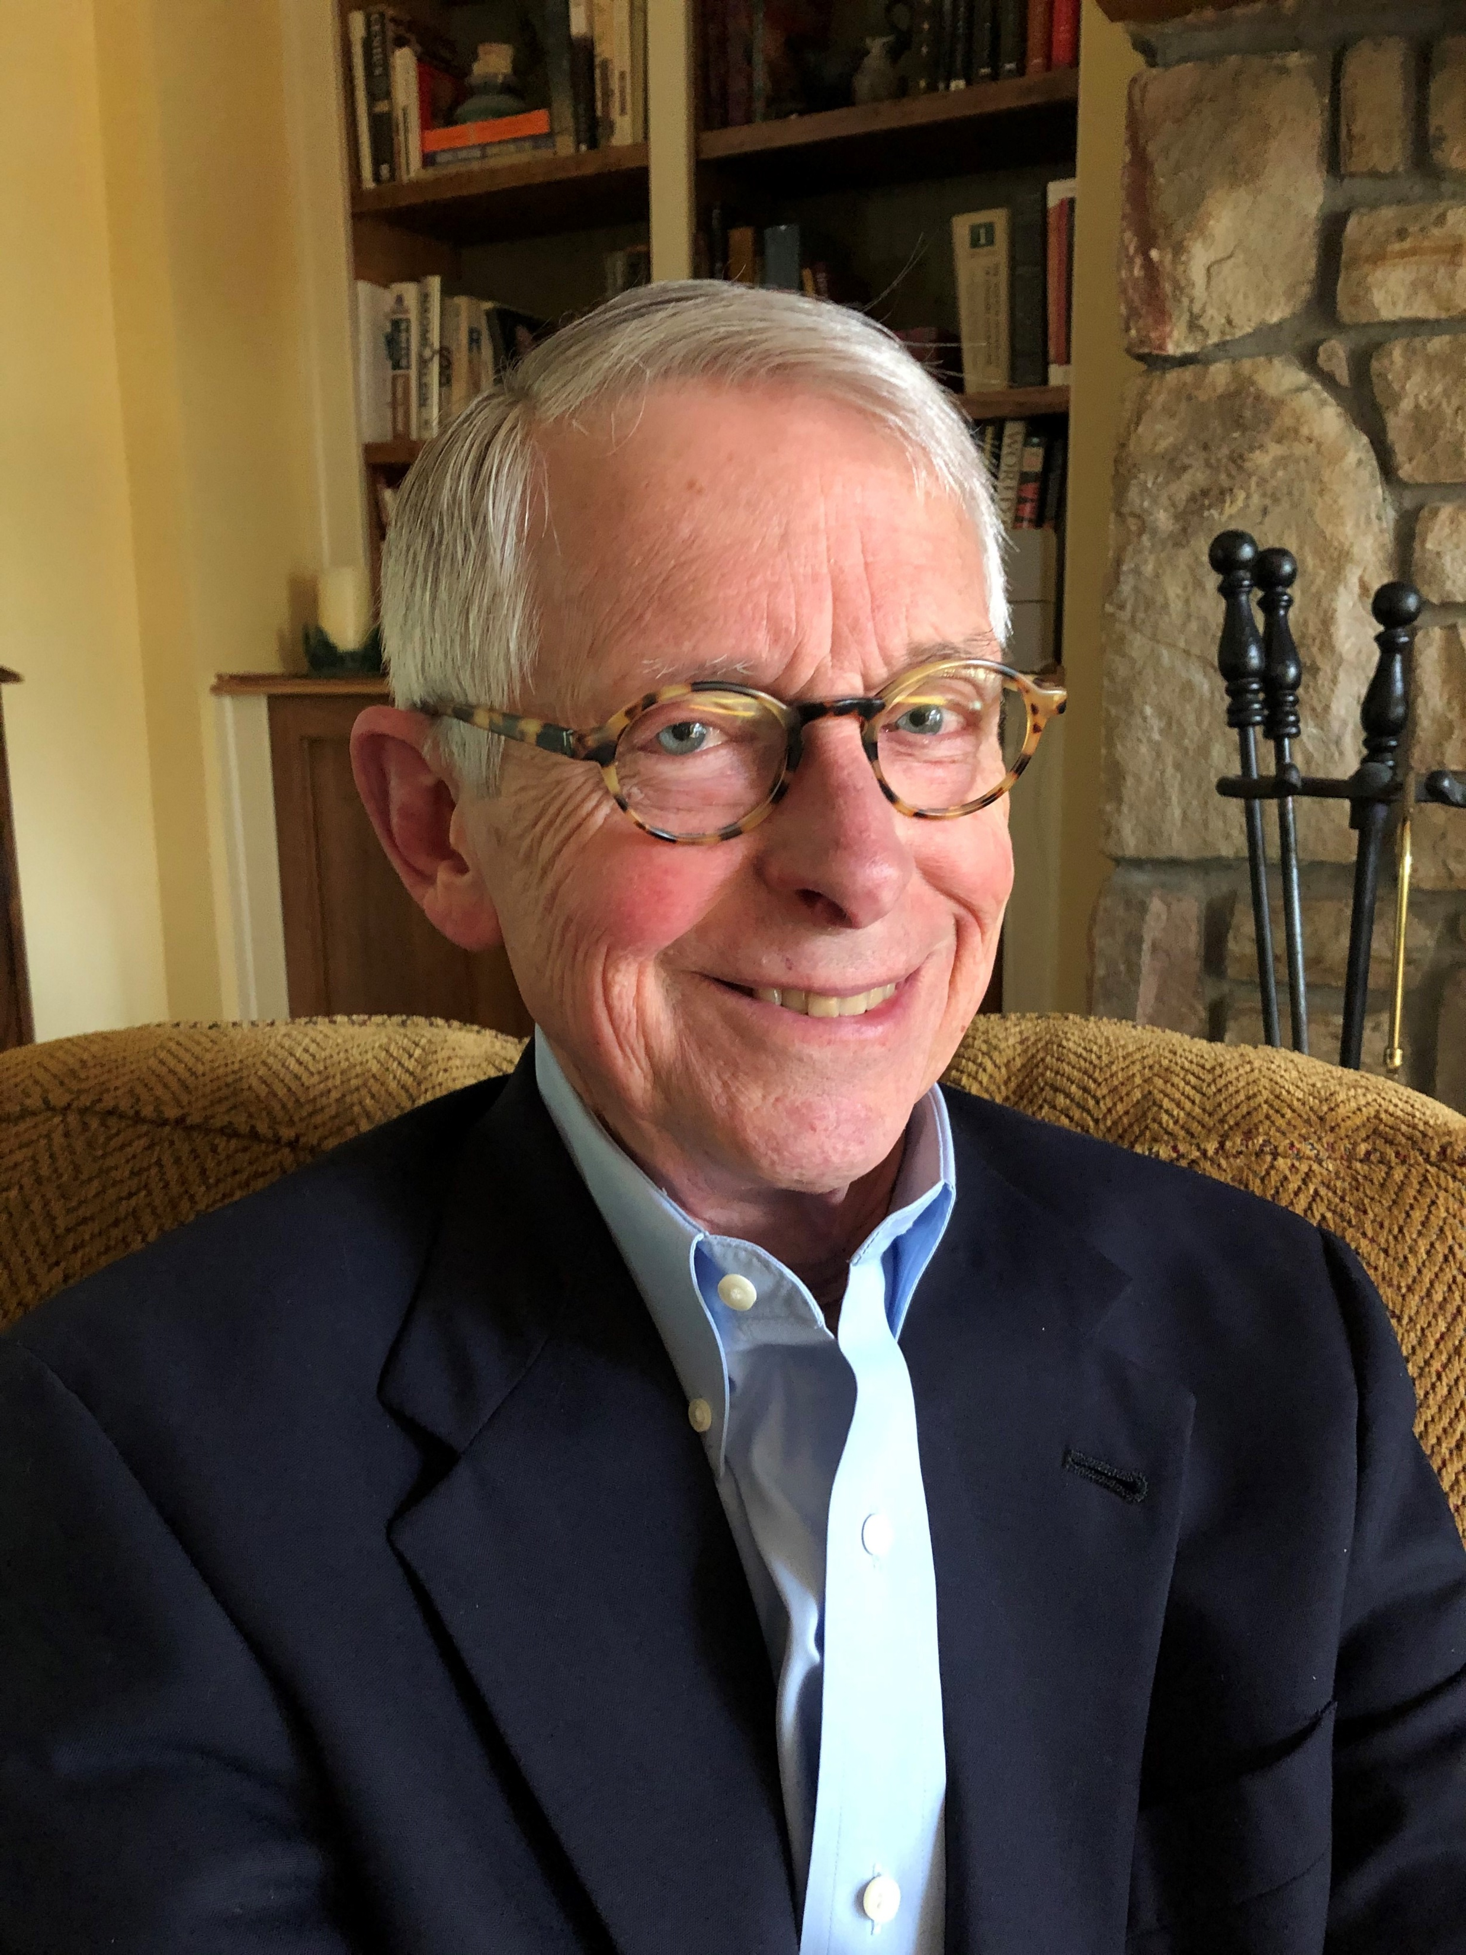
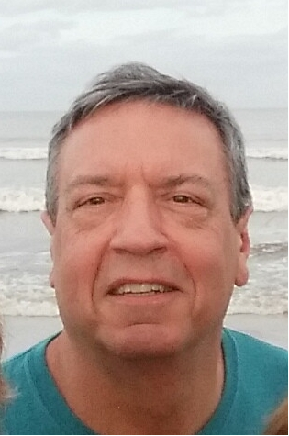
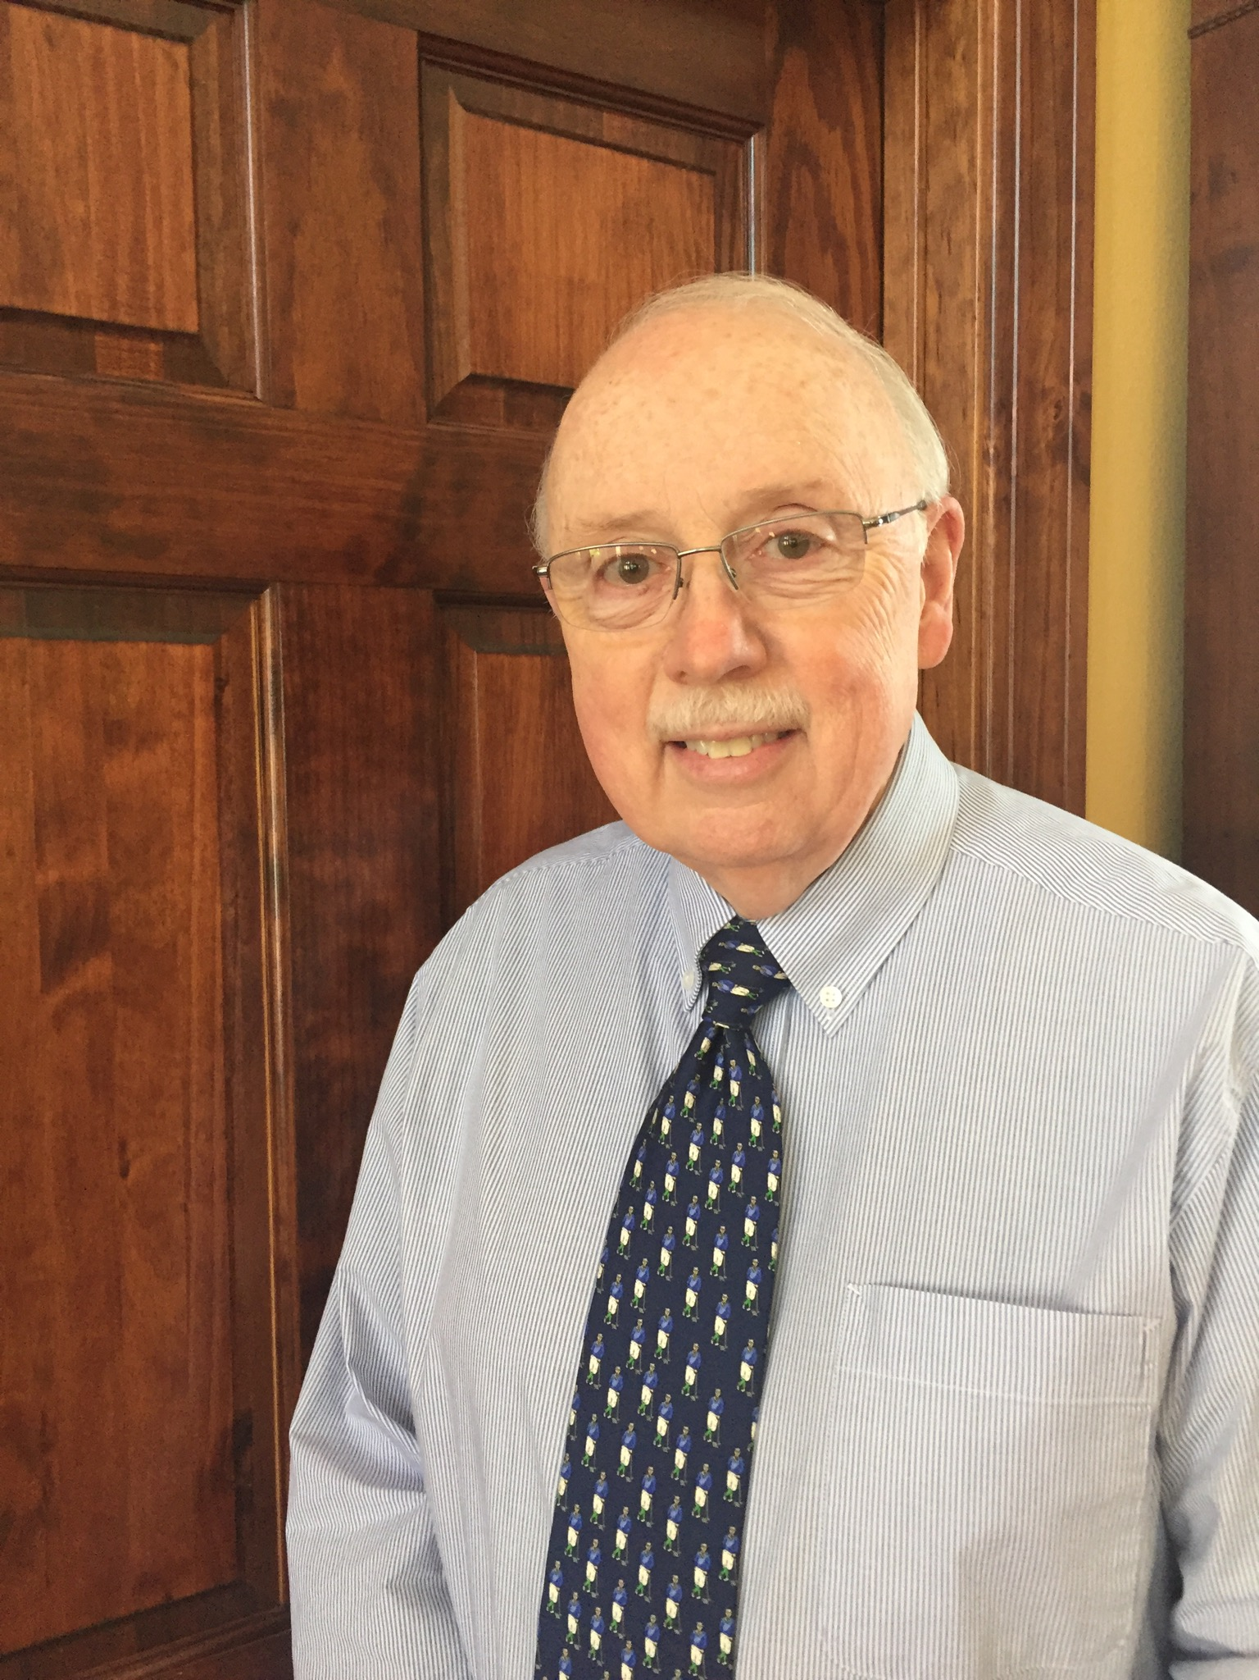
Diocesan COVID-19 Financial Team
Larry Byerly
  Diocesan Treasurer
  Treasurer, Holy Cross Valle Crucis
  Retired CPA
Carol Tannenbaum
  Diocesan CFO
  CPA, MBA
Bill Fioramonti
  Chair, Diocesan Audit Committee
  Treasurer, St. Luke’s Boone
  Retired CPA
Pat Fox
  Treasurer, Good Shephard Hayesville
  Fiscal Ministries Member
  Diocesan Audit Committee Member
  Retired Certified Auditor

Slide 4
Church Pension Group

Slide 5
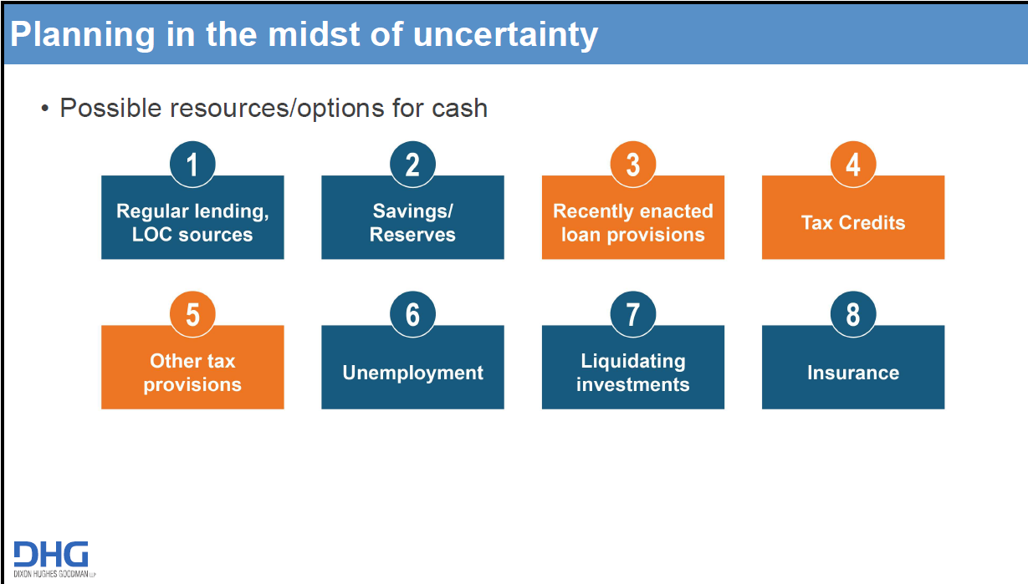

Slide 6
Coronavirus Federal Assistance Stimulus Bills

Slide 7
Families First Act (FFCRA): Emergency Sick Pay
Paid Leave Requirements
  Employer Size: <500 employees
  Effective: April 1, 2020 Expires: December 31, 2020
  Two weeks of Emergency Paid Sick Leave
Employee can’t work or telework due to below 1-6

Slide 8
Families First Act (FFCRA): Emergency Family and Medical Leave

Slide 9
Families First Act (FFCRA): Payroll Tax Credits
Leave Pay is not subject to ER Social Security Taxes
Credit includes allocated health plan costs + ER Medicare Tax (no health insurance costs if elected to defer).
Refundable: Leave costs exceeding payroll taxes owed will be refundable to the employer at the end of each quarter
IRS Form 941 beginning 2nd quarter 2020

Slide 10
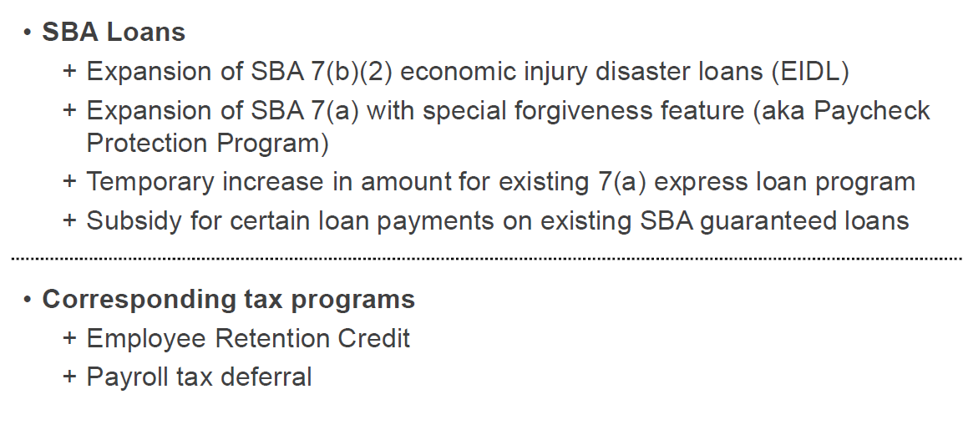

CARES Act: Non-Profit Business Overview

Slide 11
CARES Act: Economic Injury Disaster Loans (EIDL)

Slide 12
CARES Act: Paycheck Protection Program (PPP)

Slide 13
CARES Act: Payroll Protection Program – Diocesan approval?
Diocesan approval is not required to apply for PPP loan.
Bishop José wants to support each of you. If you all feel this is the best way to go, then he will support you.
Please know that in the place the application form asks for the name of the business “owner,” you must either leave this line blank, write “N/A” or “nonprofit.”
You can only use your church’s Tax ID and not the Diocesan Tax ID number.
While the PPP loan is non-collateralized, should your bank not forgive the loan 100% and the parish must repay part of the loan, please understand that the diocese and the bishop won’t guarantee any loan with diocesan funds if they are unable to pay.
Good-faith certification
  case-by-case basis, in light of a church's resources and needs

Slide 14
CARES Act:
Employee Retention Tax Credits

Slide 15

CARES Act: Delay of Payroll Taxes
Deferral of Employer Social Security taxes & ½ SECA
  50% deferral due 2021
  50% deferral due 2022
Deferral period: March 27, 2020 through December 31, 2020
Not eligible if forgiveness under PPP Loans
Impact based on FFCRA and ERC credits

Slide 16
Coordination of CARES Act & FFRCA

Slide 17
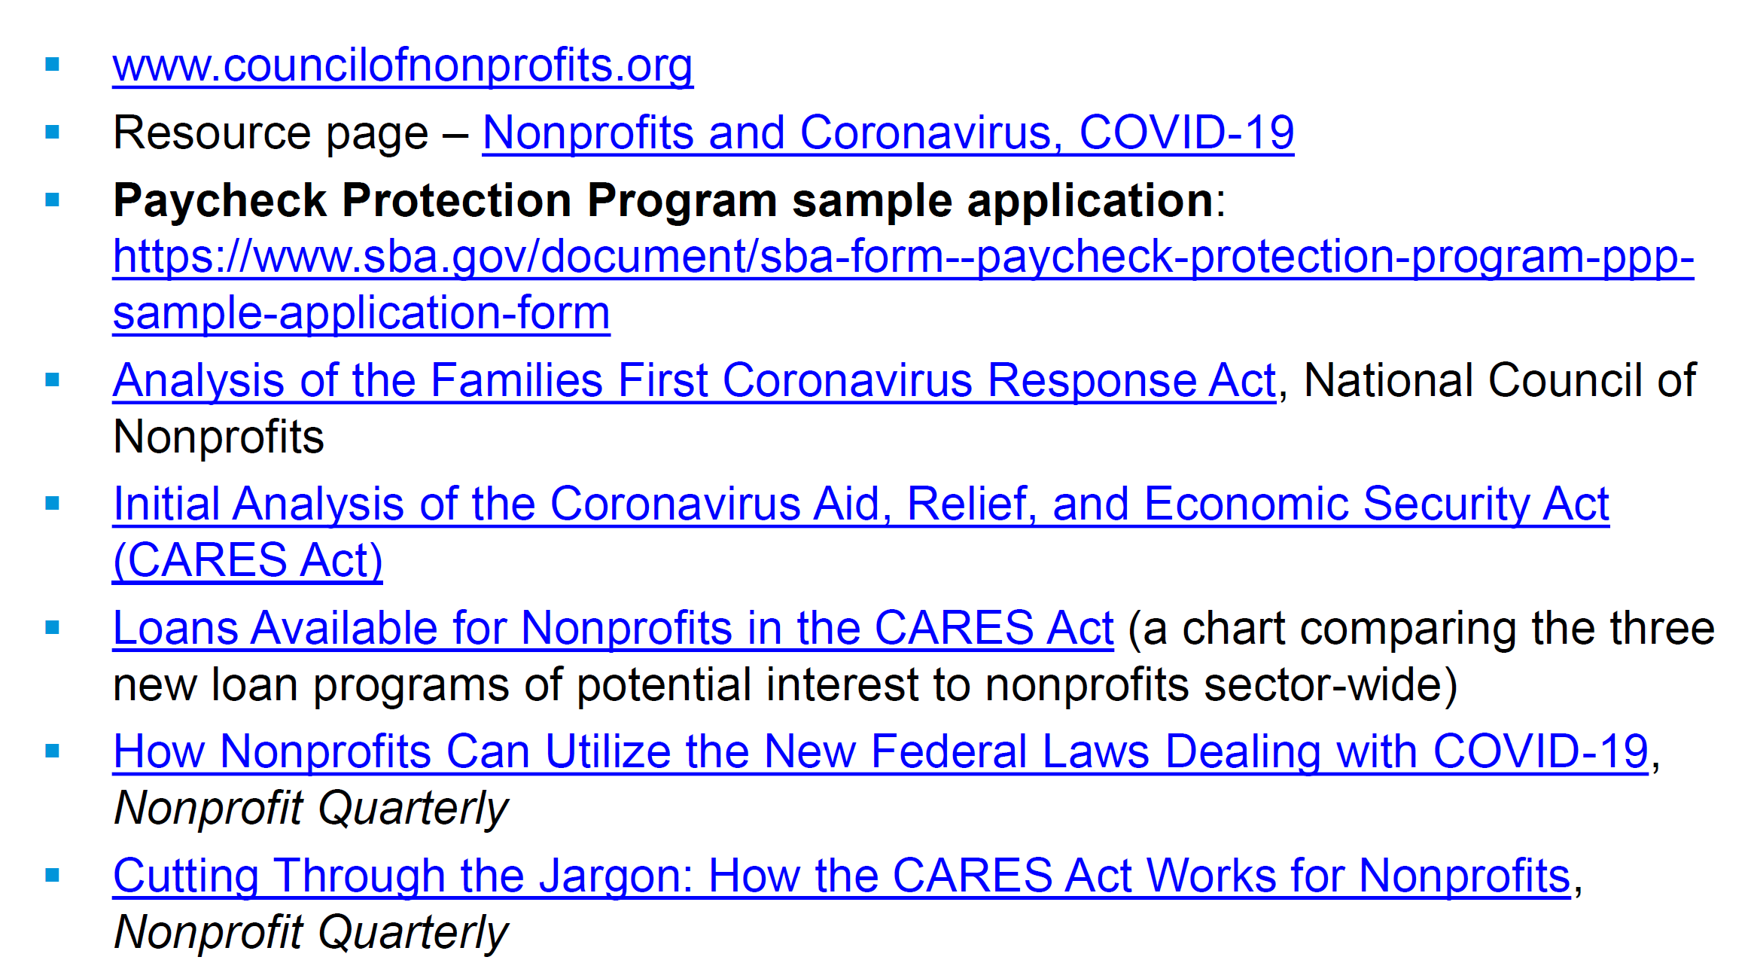
Resources on FFRCA and CARES

Slide 18
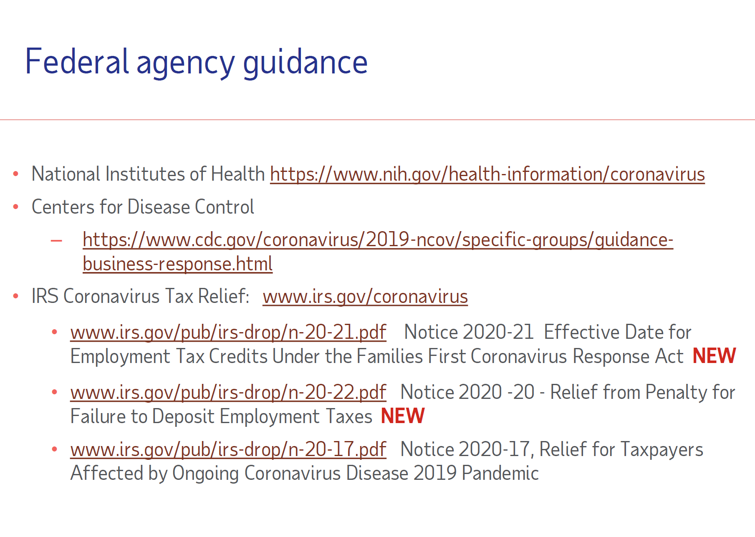

Slide 19

Next Steps: Determining Best Path for Your Church
Small Parishes: ASA < 70
  Member of Diocesan CV Team will be assigned to assist in analyzing best option.
Mid-size Parishes: ASA 70 to 175
  Diocesan CFO to work with Parish Treasurer or designee on specific questions
  Pair with another church same size to share information and determine best options
Large Parishes: ASA > 175
  Diocesan CFO to recommend webinars to Parish Finance/Treasurer
  Diocesan CFO to work with parish designee

Slide 20

Next Steps: Who to Contact
Assign one person within your parish as primary point of contact
  Small Parishes: ASA < 70 (32 churches)
    Member of Diocesan CV Team will reach out. Look for introduction email. This will be your primary point of contact.
  Mid-size Parishes: ASA 70 to 175 (23 churches)
    Contact Diocesan CFO@ cfocarol@diocesewnc.org with questions
  Large Parishes: ASA > 175 (8 churches)
    Contact Diocesan CFO @ cfocarol@diocesewnc.org with questions
Slides and links to webinars will be posted on Diocesan COVID-19 resource page
Keep in touch – we would like to track each parish’s plan of action

