Slide 1

2026 Diocesan Proposed Budget
Notes:
Bishop to introduce with prayer

Slide 2

2026 Budget Focus
In 2026 we will maintain support to current ministries while increasing funding in several areas, including Congregational Vitality.
Market performance this year is expected to be steady. A 4% increase is expected, covering the annual distributions.
Notes:
Bishop
Opportunity/New Initiatives Budget Year
We are flat Parochial Report revenue.

Slide 3
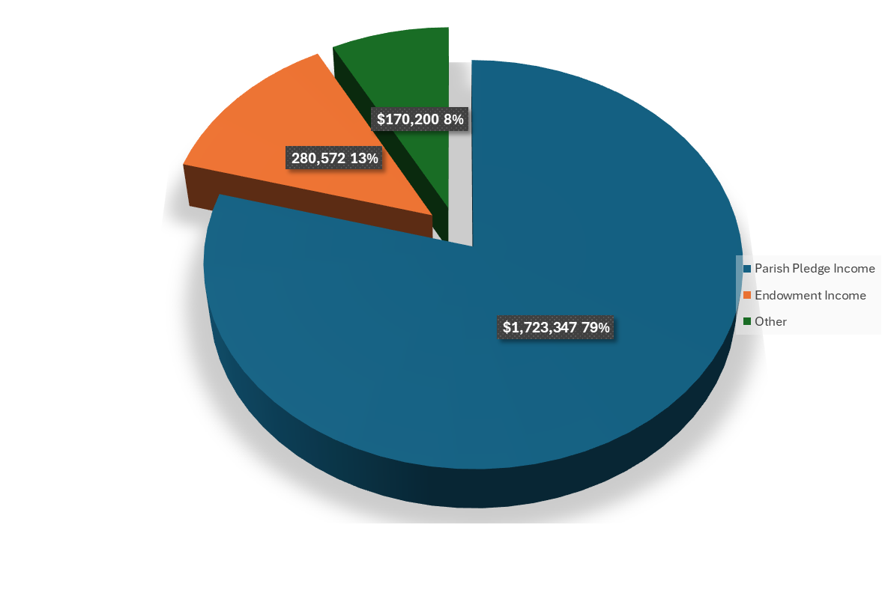
2026 Proposed Diocesan Revenue
Notes:
Jack
Emphasize the generosity!
Budget based on 2024 PR operating income, 9.81% 3 yr commitment average
Pledge commitments due 10/31
*if pledges are higher (hope they are) additional funds to grants

Slide 4
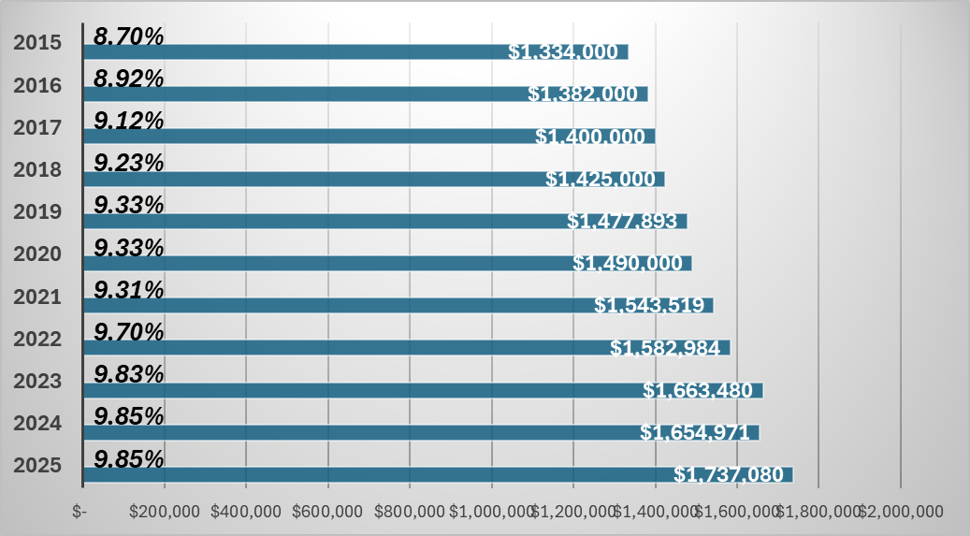
Parish Pledge Income
Notes:
Jack

Slide 5

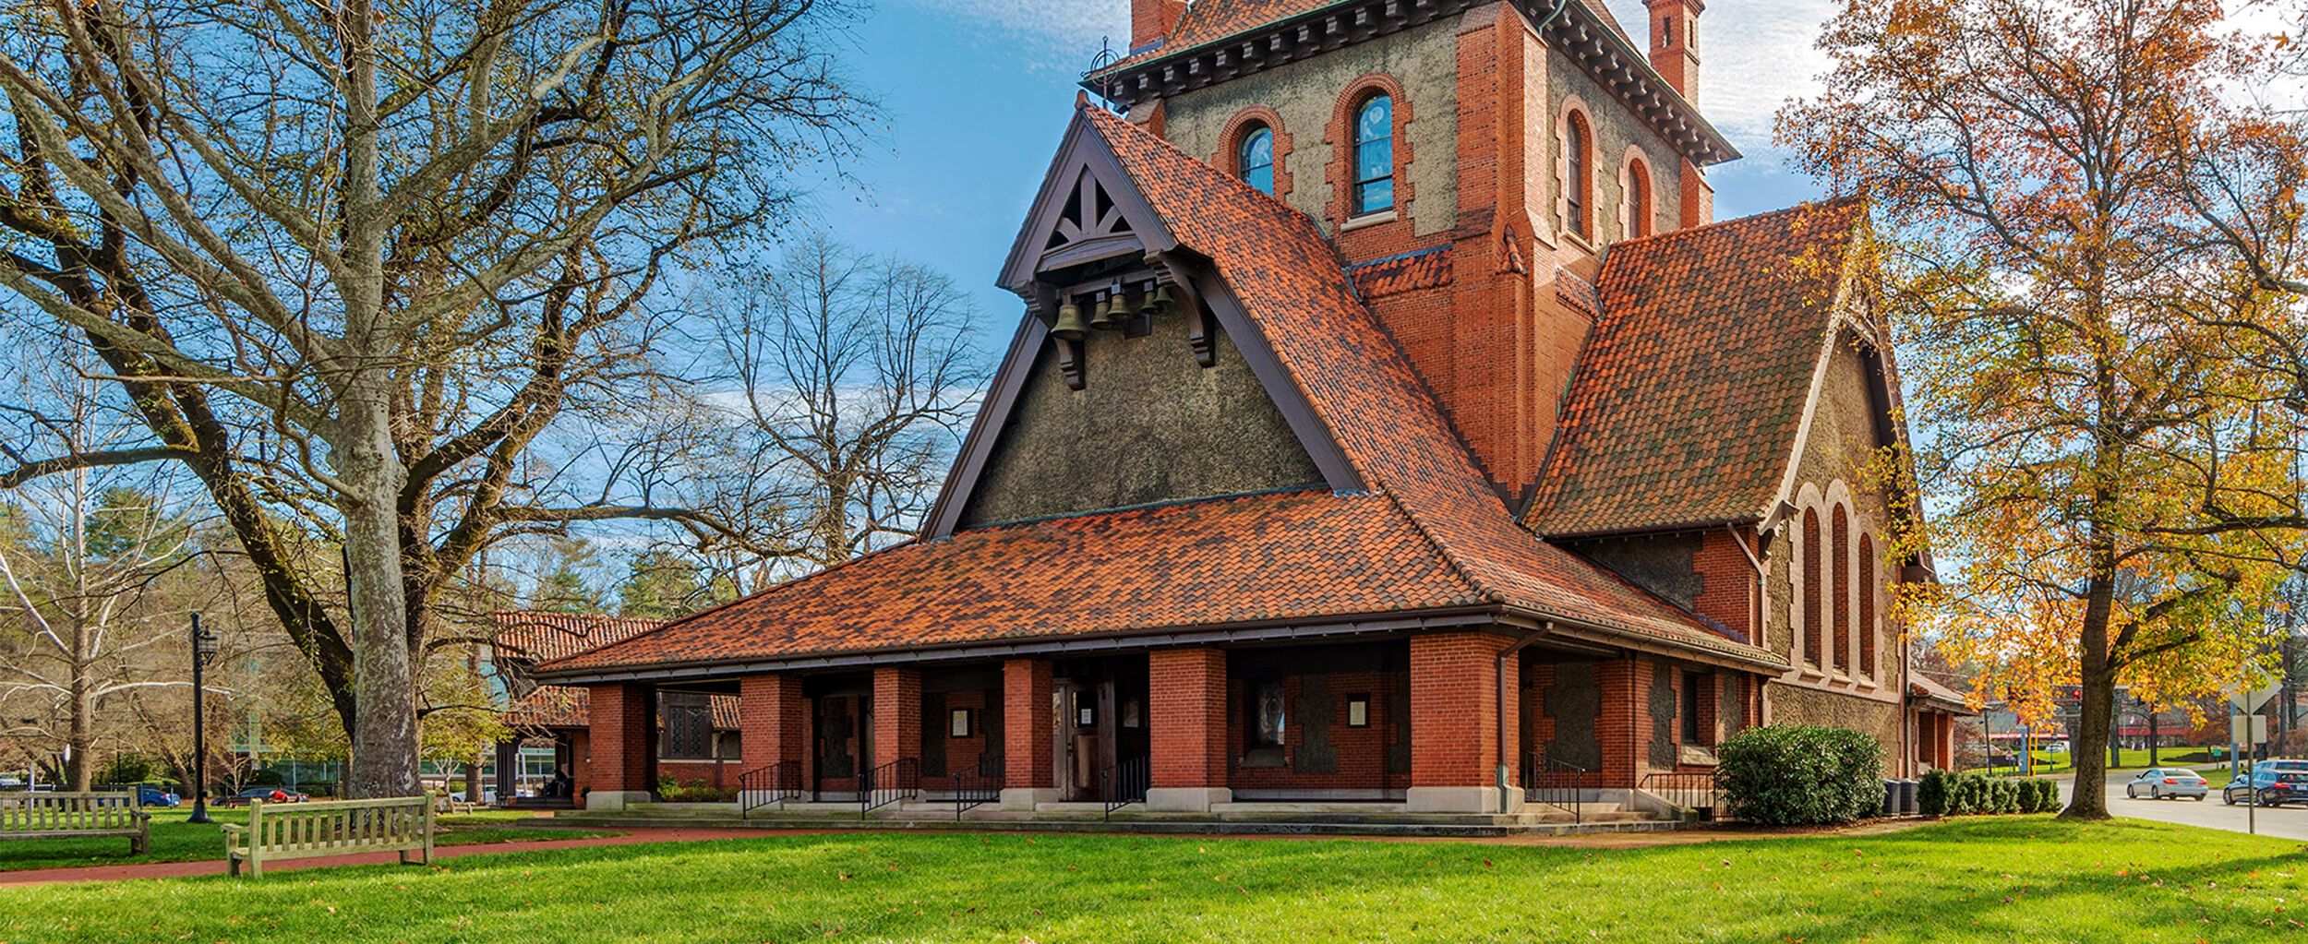
Parish Pledges
2026 Budget: $1,723,347 (9.81%)
If all Parishes gave at 10%: $1,756,725
Notes:
Jack
Bishop’s wish is for all to give 10% and we can fund/support additional programs and grants
That would be an additional 33,378!
2026 Budget is based on 9.81% which is the 3-year average - conservative

Slide 6
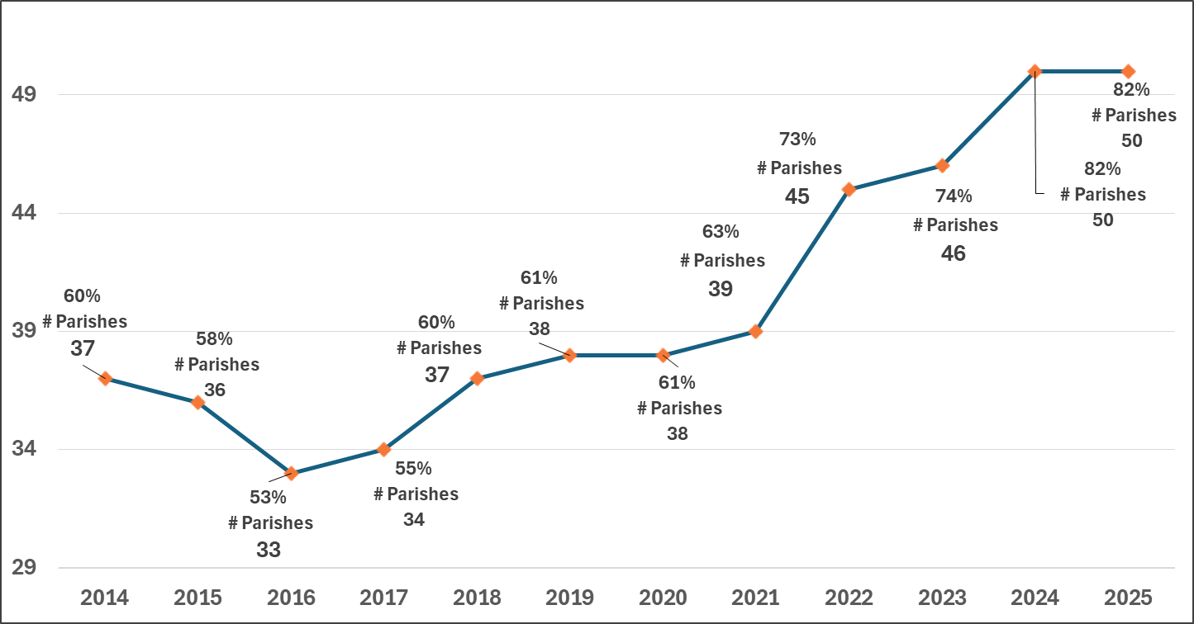
Parishes Giving 10% NOI or more
Notes:
2019 and 2020 same levels
2021 up in spite of COVID
2022 WOW jumped to 73% of parishes giving 10%
2023 up to 74%
2024 & 2025 amazing 50 parishes pledged at 10% level which is 82%

Slide 7

Notes:
Emphasis on total comp – includes salary, benefit, education, travel
New very part-time position to assist CTO with transitions ($35,000)
CFO reducing to ¾ time
2% average increase in salary
5% estimated for Health. 2% Dental increase
WE DO A LOT WITH LITTLE STAFF

Slide 8

Diocesan Office Administration
Notes:
Highlight drop since 2016 to 2023
2019 – Reviewed all contracts, Decreased Network Support, new telephone contract, reduced banking fees & payroll fees
2020 - Increase Networking/Support costs, upgraded staff equipment
2021 - Covid remote working savings, increase was in Network support – new server and additional security
2022 - Inflation – contract increases
2023 - Costs for fiber Optics approx. $6,000 + $3,000 installation/support
2024 - New telephone system due to carrier elimination
2025 - Back to basics – oops basement issue in actuals
2026 - Back to basics…again
ALL Staff involved in managing admin costs

Slide 9



2026 Focus:
On-Going Mission
New Initiatives
Grants
Notes:
Segway slide

Slide 10

Programs, Mission & Grants
Represents 58.1% of Pledge Income up from 56.6% in 2025
Notes:
Overall costs reduced $35K
- Ministry Dev down $19.5K ½ yr Curate, IONA reduced
- Lifelong Christian Ministries up $27K, increase BRSC Director plus staff & health
- J&O decrease w/o HHH earnings to fund
- Vitality Ministry: add bookkeeper, decrease grants
- Latino: La Capilla to absorb $5K Miguel

Slide 11
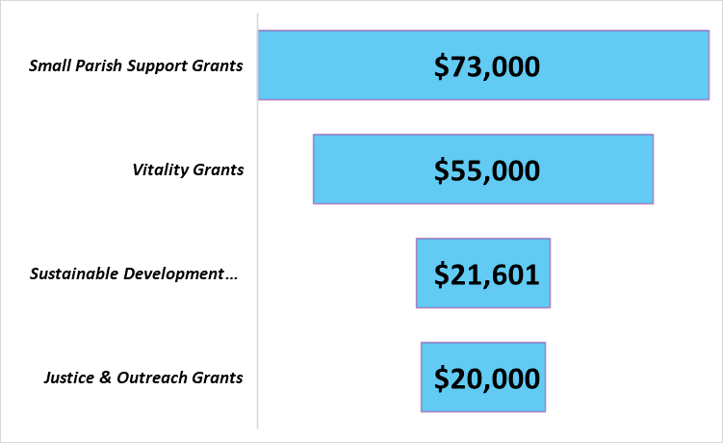

Grants included in Program Budgets
These funds are designated for ongoing support to small churches as well as for initiating programs and practices that encourage congregational vitality, growth and mission.
Justice & Outreach income is from operations (parish pledges) now that HHH Fund is exhausted .
Notes:
Additional pledge dollars will go to grants & programs

Slide 12

Mission Initiatives:
Notes:
Bishop’s slide

Slide 13

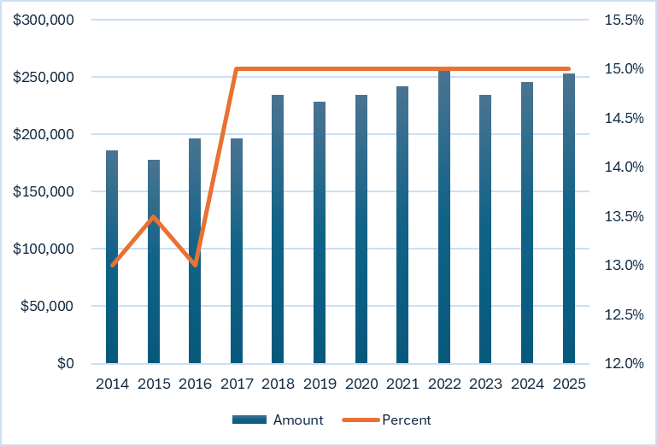
Diocesan pledge to
Notes:
Carol
Highlight prior to 2017
same 15% commitment but two things occurred –
Increase of $7,300 in 2025 as our revenue grows

Slide 14

The Balanced Budget
Notes:
Cash on cash – balanced
Depreciation is the using up of an asset over time (it’s useful life). We fund depreciation through our budgeted reserves

Slide 15


2026 Budget Questions and Answers

