Slide 1




Disaster Preparedness 101

Slide 2
Agenda
Opening Prayer
Introductions
Disaster Cycle & Emotional Life Cycle of a Disaster
Household Preparedness 101
Church Preparedness 101
Additional Resources
Q&A

Slide 3
Disaster Preparedness 101 | opening prayer
Dignity & Respect (Baptismal Covenant)
O God, Our times are in your hand. In the midst of uncertainty lead us by your never-failing grace as we seek to be agents of healing and hope. Walk with us through difficult times; watch over us in danger, and give to us a spirit of love and compassion for those who suffer and mourn. And finally, remind us that you have promised never to leave us so that even in the valley of the shadow of death your love may be felt, through Jesus Christ our Lord. Amen.
Prayer for Times of Disaster by The Rev. Lyndon Harris

Slide 4

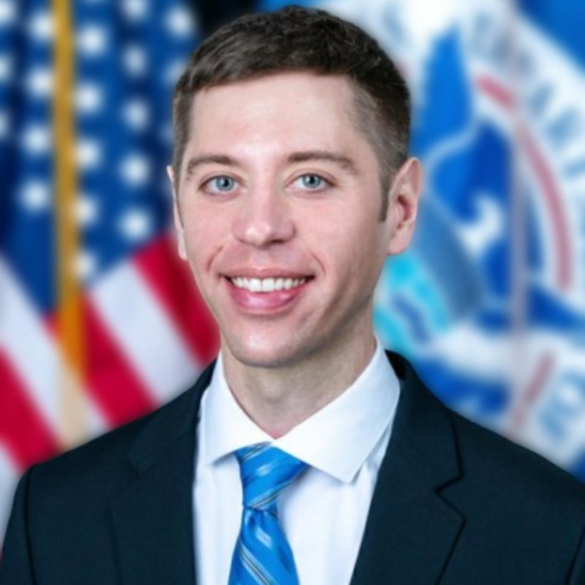

Disaster Preparedness 101 | introductions
Dignity & Respect (Baptismal Covenant)
Katie Mears+ Race Hodges Kelsey Davis+
Sr. Technical Specialist
US Disaster & Climate Risk
Episcopal Relief & Development
Program Officer
Global Disaster Response & Resilience
Bishop’s Deputy for Disaster Response & Recovery
Episcopal Diocese of WNC

Slide 5
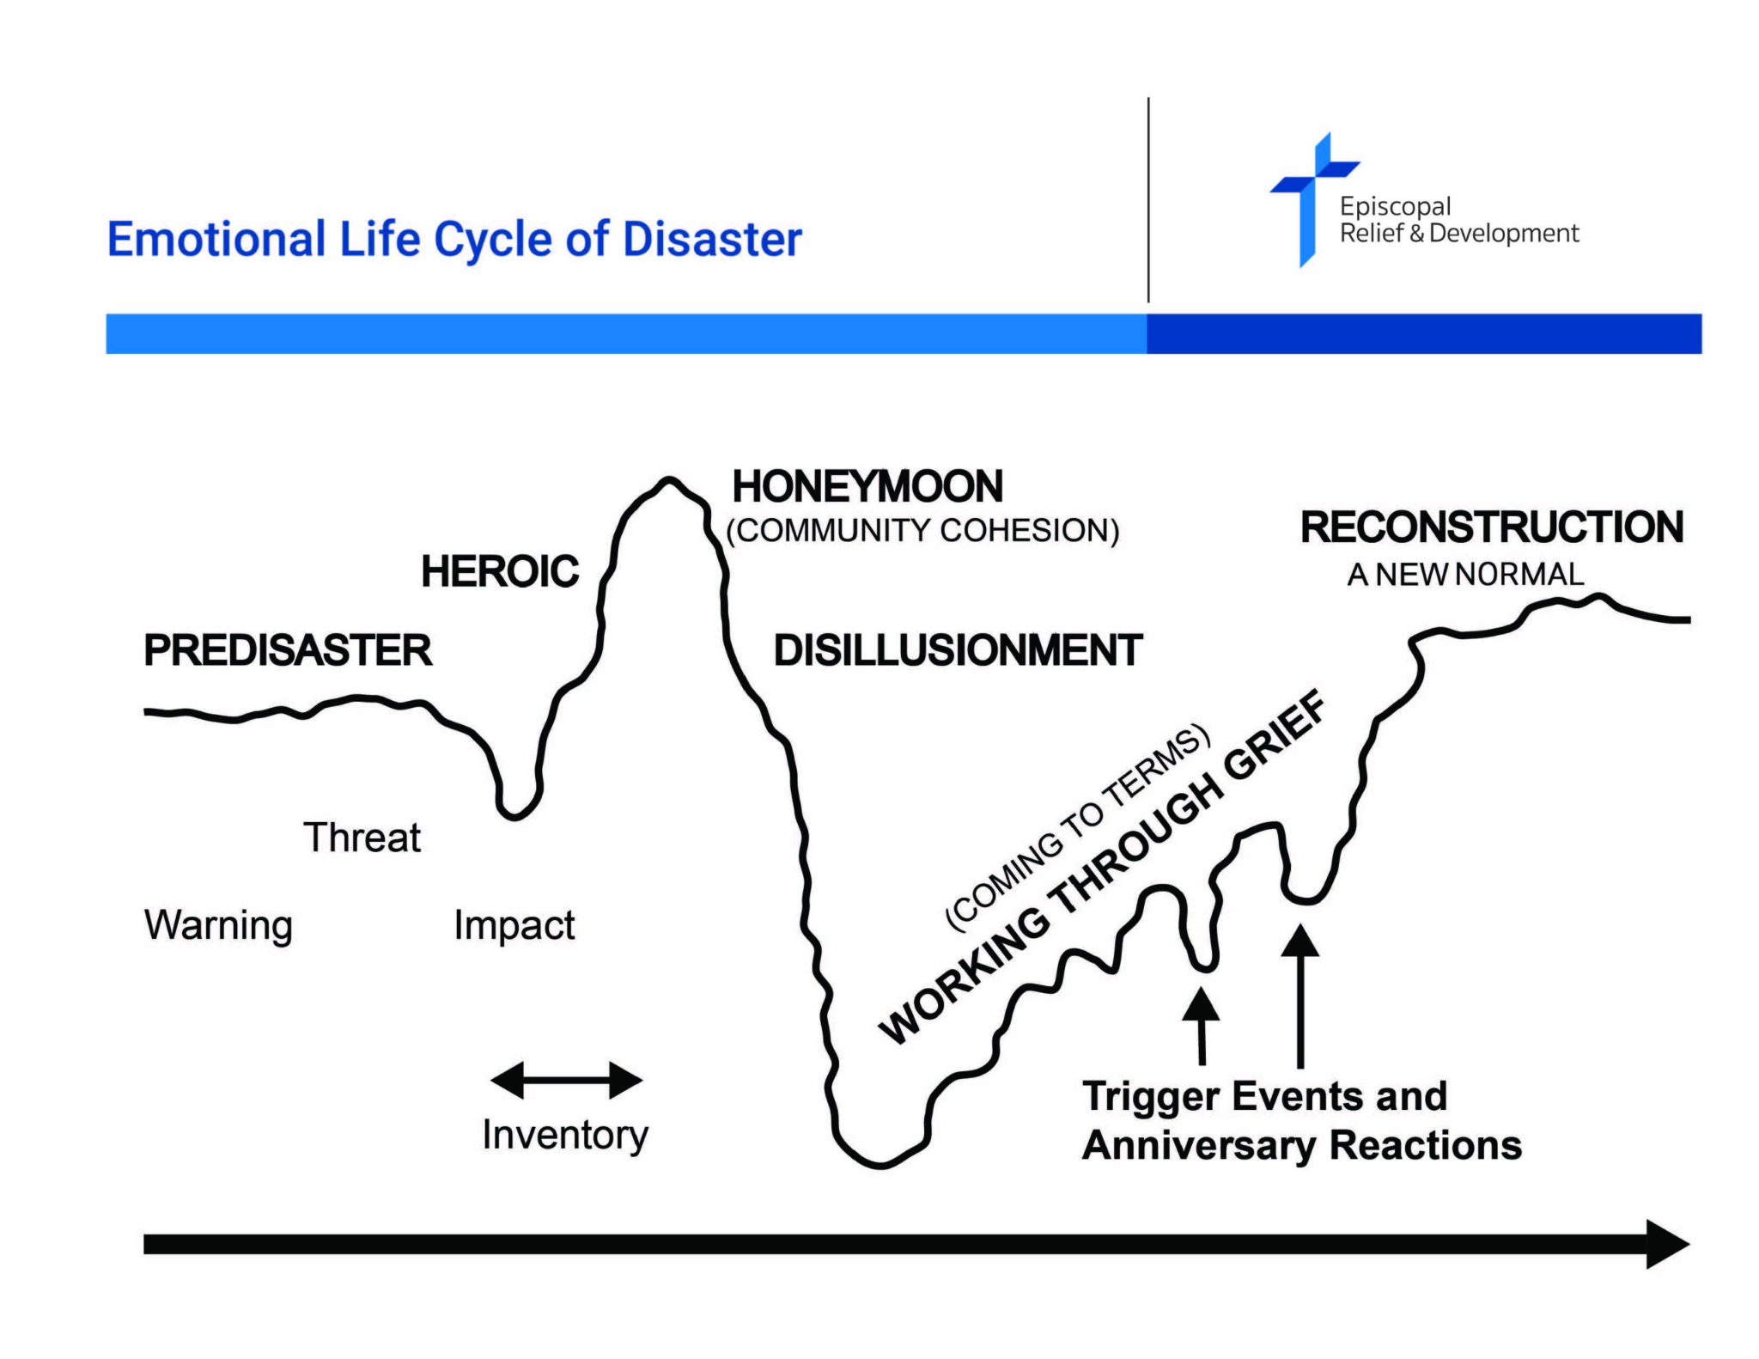
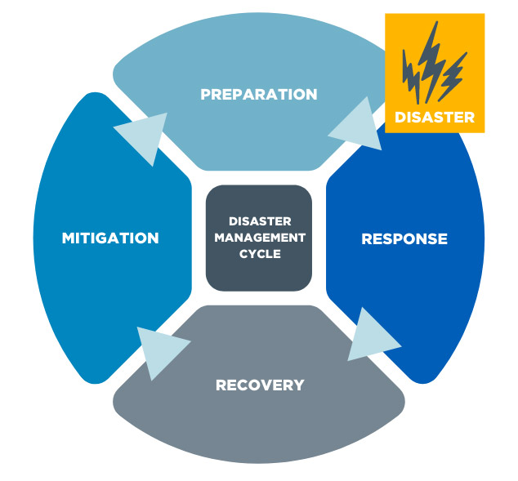
Disaster Preparedness 101 | disaster cycles

Slide 6
Disaster Preparedness 101 | household prep
Dignity & Respect (Baptismal Covenant)
IMPORTANT INFORMATION
A large waterproof container or bag to store your emergency
kit items.
Copies of important papers - you can keep paper copies or
store them on a flash drive.
Contact information - the list should include phone numbers
and emails of your family and friends, including one out-of state contact.
Cash in different denominations - shoot for $100 total or as
much as you can; try saving a couple dollars each week this
season.
A spare set of keys for your house and car.
A map of your area and any known evacuation routes.

Slide 7
Disaster Preparedness 101 | household prep
Dignity & Respect (Baptismal Covenant)
IMPORTANT INFORMATION
Make copies of your credit card numbers, including
customer service numbers, and store with other important
documents. It will be easier to replace lost or stolen cards
if you have this information on hand.
Memorize an emergency contact phone number (or two).
This will come in handy if your cell phone is ever broken,
missing or stolen.

Slide 8
Disaster Preparedness 101 | household prep
Dignity & Respect (Baptismal Covenant)
IMPORTANT INFORMATION
Know how to shut off the water, power and gas in your
home. After a disaster, being able to turn off these utilities
can help ensure your safety and reduce the risk of further
damage to your home.
Backup your computer files on cloud storage and/or
external hard drive. Save all files that are important to you.
Have a conversation with your family members about what
you would do if a disaster happens when you are all at
home.

Slide 9
Disaster Preparedness 101 | household prep
Dignity & Respect (Baptismal Covenant)
EMERGENCY KIT (FOR 1 ADULT)
FOOD
3 gallons of water - include some in gallon jugs and some in
smaller bottles
3 cans of food you’d like to eat such as beans, meat, fish,
pasta or soup that would taste good cold
1 can of fruit or veggies
Lots of tasty snacks such as dried fruit, nuts, seeds,
crackers, granola bars, wasabi peas and peanut butter
A beverage that you would like to drink such as juice, a
sports drink or oral electrolyte solution
Comfort food such as candy or chips; be sure your
chocolate has a candy coating so that it doesn’t melt!
Eating utensils
Manual can opener

Slide 10
Disaster Preparedness 101 | household prep
Dignity & Respect (Baptismal Covenant)
EMERGENCY KIT (FOR 1 ADULT)
HEALTH
A week’s supply of medication and vitamins.
Health Items - first aid kit, thermometer, allergy and pain
medication, menstrual supplies, gloves, hand sanitizer, spare
glasses or contacts, K95 masks.
Toiletries - may include comb, soap, shampoo, deodorant,
washcloth or a small towel.
1 roll of toilet paper

Slide 11
Disaster Preparedness 101 | household prep
Dignity & Respect (Baptismal Covenant)
EMERGENCY KIT (FOR 1 ADULT)
HEALTH
Hot Hands, blankets, etc. to stay warm. Poncho, umbrella to stay dry.
Extra set of clothes stored in a plastic bag.
Sunscreen, bugspray, lotion.

Slide 12
Disaster Preparedness 101 | household prep
Dignity & Respect (Baptismal Covenant)
EMERGENCY KIT (FOR 1 ADULT)
TOOLS
Cell phone charger
Charging supplies- solar, batteries, generators.
Basic tools- screwdriver, utility knife, pliers, and duct tape
Pen, marker, notebook
Disinfecting wipes
Whistle
Flashlight with extra set of batteries
Scissors
Matches

Slide 13
Disaster Preparedness 101 | church prep
Dignity & Respect (Baptismal Covenant)
Appoint a Disaster Planning Team
Outline a Disaster Response Plan/Assign Duties
Connect with Dio Disaster Response Team
.
1
2
3

Slide 14
Disaster Preparedness 101 | church prep
Dignity & Respect (Baptismal Covenant)
Congregation
Make parishioner contact list (electronic & physical copy), note those with special needs or special skills.
Safety
Make a communication plan for who will check in with whom after the event (i.e. Priest call A-G, Deacon H-M, Senior Warden N-S, Junior Warden T-Z).
Designate a backup for comms plan in case someone is unavailable.
Know your neighbors & local community organizations.

Slide 15
Disaster Preparedness 101 | church prep
Dignity & Respect (Baptismal Covenant)
Create PDF file for all important documents such as:
Articles of Incorporation
Parish By-Laws
Insurance Policies
Minutes of Meetings
Key Files
Parish Records
Service Attendance
Parish Directory
Passwords
Comms system
Emergency Contact numbers
Copies of key financial records
Financial Aid
& Admin

Slide 16
Disaster Preparedness 101 | church prep
Dignity & Respect (Baptismal Covenant)
Draw and post a chart of facilities to show hook-up & shut-off points for all utilities:
Water connection & shut-off valves
Electricity service entrance and master fuse breaker box
Telephone and computer connection service entrance
Natural gas service connection and master valve
Security system control connection
Take pictures and/or video of all areas inside and outside of church to show pre-disaster condition. Keep them on file and current.
Church Building
Safety

Slide 17
Disaster Preparedness 101 | church prep
Dignity & Respect (Baptismal Covenant)
Take pictures of any damage as soon as conditions are safe to do so.
If you are not going to go with insurance endorsed contractors, make sure to secure three bids.
Save and file any communications received from Church Insurance, especially settlement letters (which may be physical letters or emails.)
Insurance &
Rebuilding

Slide 18

Disaster Preparedness 101 | additional resources
Dignity HHow Episcopal Relief & Development Helpsaptismal Covenant)
Immediate Recovery
Emergency grants get distributed, intended for community not just congregants, helps with immediate needs: food, water, money, etc
Community-Based Response:
How can you leverage the gifts/assets of your congregation to meet post-disaster needs?
Does your parish have connections with organizations that serve historically marginalized or underserved communities?
Make relationships with these organizations before a disaster!
1
Long-Term Recovery
3
Congregational grants, utilizes gifts of the church (people, place, posture), long-term needs like shelter, relocation, repair, aid, etc.
2

Slide 19
Disaster Preparedness 101 | additional resources
Dignity & Respect (Baptismal Covenant)
Episcopal Relief & Development : A Season of Resilience
Episcopal Diocese of WNC: Relief & Recovery Hub
Choctaw Nation of OK: First 72 on You

Slide 20
Disaster Preparedness 101
Questions?

