Slide 1
Communications as Evangelism 4
BEING SEEN:
MEDIA OUTREACH
Episcopal Diocese of Western North Carolina

Slide 2
WHY BE SEEN?
A LITTLE COVERAGE CAN GO A LONG WAY
WELCOMING THROUGH GETTING THE WORD OUT
Notes:
Before we get into this, let’s talk about why we want to be covered by the media. What does everyone think?
The more people see the life of your church in a positive light, the more it encourages people to consider going to church.
Sharing our stories is an important part of being connected to our community and getting outside the walls of the church.
There is always the risk of being misrepresented, but remember, journalists are people too, capable of conflict resolution.
There is also reward within the risk.

Slide 3
BROADCAST VS. PRINT
BROADCAST
TV news stations want heavy-hitting, entertaining stories. Advocacy events/stories can work well.
PRINT
Newspapers want community coverage from all angles. You might ask about writing a column for the faith/religion section among other things you send.
Notes:
History, racial equality, and LGBTQ+ stories can be interesting to TV stations and newspapers.
WLOS picked up the story of Dean Sarah's installation. https://wlos.com/news/local/new-dean-installed-historic-biltmore-church-senior-priest-sarah-hurlbert-cathedral-all-souls-episcopal-diocese-western-north-carolina
Print papers, or local news websites, are more likely to pick up minor things like a church potluck or upcoming events.
All reporters are hungry for stories, but not everything that seems exciting to you is newsworthy in the eyes of the community. You can always try for the new hires, VBS, and building projects, especially if it’s a slow news week. More on that later.

Slide 4
WRITING A
PRESS RELEASE
Create a catchy headline and informative subhead.
Draft a compelling lede.
Include actual quotes by actual church officials.
Write the quotes yourself so they fit where you need them and get them approved by the speaker. This can be a quote about why it's an exciting/important/relevant thing.
Notes:
The lede is the first sentence of a press release. It should include the who, what, when, where, and why. The rest of the release goes into the details and expands upon it.
Quotes can be as simple as, "It's a really wonderful event and we're excited to be a part of it."

Slide 5
WRITING A
PRESS RELEASE
Compose a tight nut graph (everything distilled in a nutshell).
Inverted pyramid
By paragraphs 3–4, if not sentence three or four, the reader should know everything necessary.
A good guide might be:
Lede
Quote
Nut graf (everything in a nutshell)
Quote from official/rector
Include contact info for people in your organization for interviews.
If you have the skill, lay it out as a newspaper story so they can "see" it and more easily envision it in their own paper.
Always include dynamic art. No grip-and-grins.
Examples:
St. James Rector Call
Barrier Breakers: The Pilgrimage
Cold Mountain Music Festival
Notes:
Whatever type of photo you include, be sure to provide the names of the people in the photos. Writing a short caption (called a cutline) really helps.
Photos should also include a photo credit if needed.

Slide 6
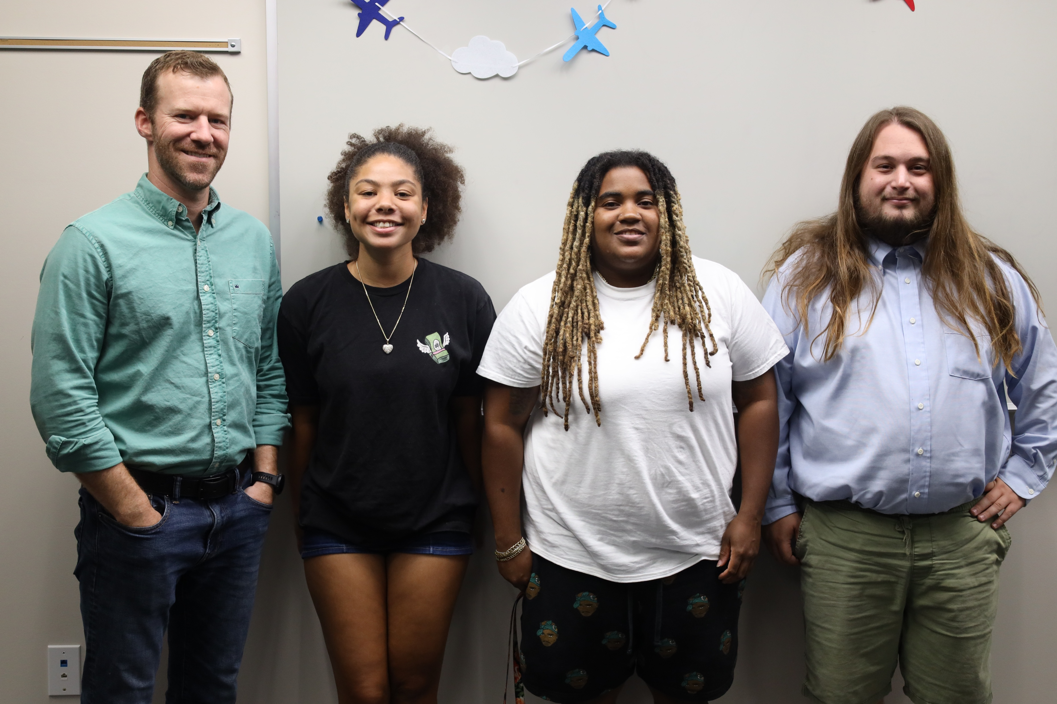
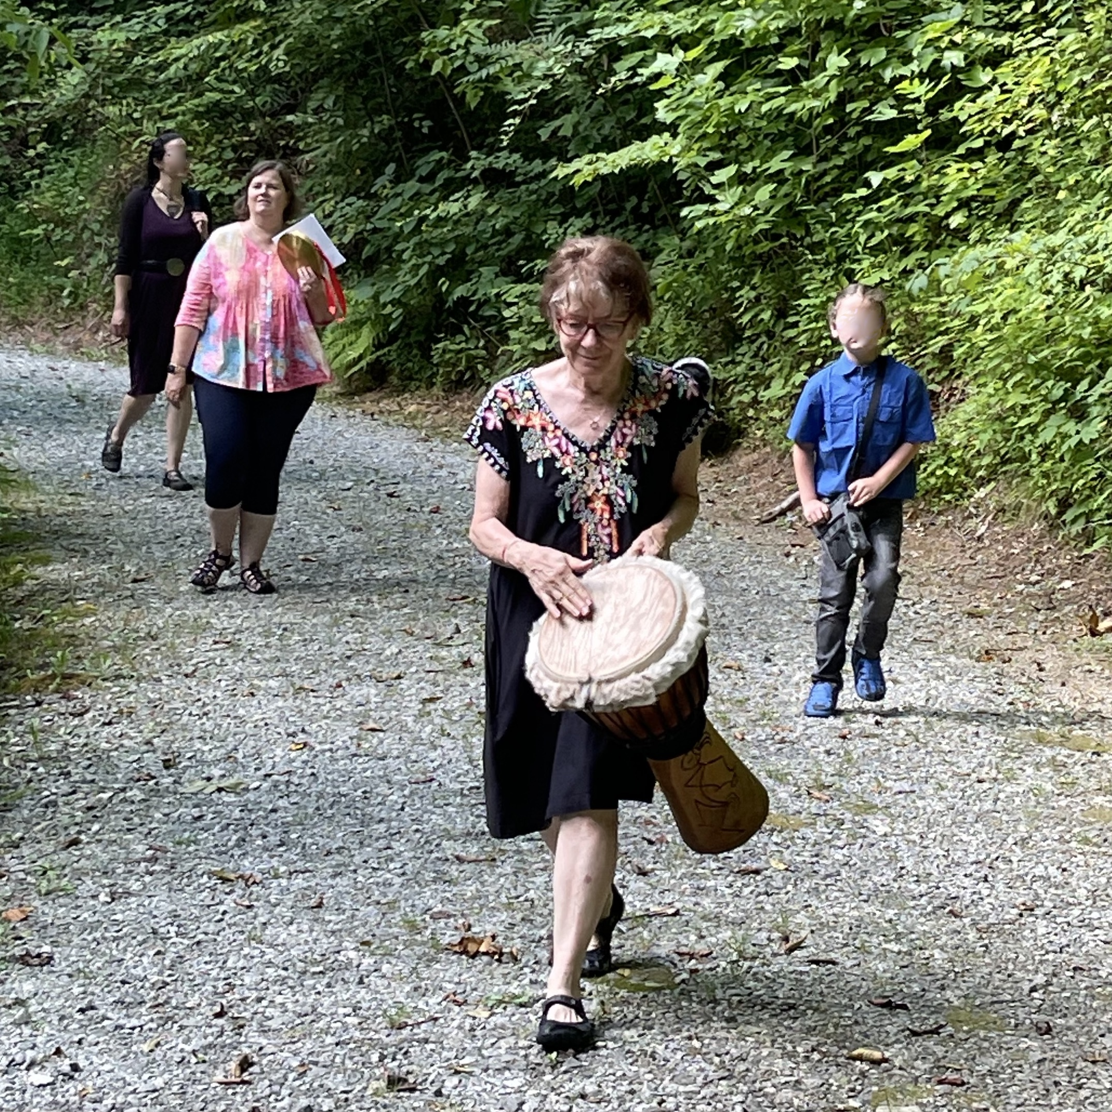
Grip and Grin
Dynamic photo

Slide 7
TALKING TO REPORTERS
SAY IT SMART
Reporters are typically charismatic and friendly, but the reporter is not your friend. Be mindful of what you say to them.
TIP
DON’T GO ‘OFF THE RECORD’
It’s not actually a thing, just up to the reporter’s discretion.

Slide 8
TALKING TO REPORTERS
Have a single voice responsible for talking to or being interviewed by the media.
Decide the point or points you want to make and return to them, no matter what is being asked.
Never say anything you don't want attributed to you.
If you say, "Some churches believe the Bible teaches that homosexuality is a sin to be condemned in the strongest of terms, but in The Episcopal Church we welcome all."
That can easily become, through the power of editing, "The Bible teaches homosexuality is a sin to be condemned in the strongest of terms." Yikes!
Only speak for yourself. "The Episcopal Church believes LGBTQ+ people are beloved by God and to be celebrated as God's own children."

Slide 9
IF IT’S BAD COVERAGE
DON’T BURN BRIDGES, TALK IT OUT
Contact the editor and discuss what happened.
ASK THEM TO FIX IT
If the reporter got something wrong, ask for a correction.

Slide 10
TYPES OF CONTENT
FEATURE
Human interest stories that tend to focus on one person or organization doing cool things, like a new pastor.
Reach out to reporters about interesting aspects of your
church community.
WHAT MAKES IT NEWSWORTHY?
Impact, timeliness, prominence, proximity, oddity, novelty, conflict, human interest.
OPINION/COLUMN
EVENTS
Many local papers have an opinion section for letters to the editor, opinion pieces, and columns.
Reach out to the editor about writing a regular column.
Happenings that are open to the public and coming up soon.
Submit your event to the community calendar, do a write up afterward, send photos.
Notes:
These are types of content to consider submitting to your local new outlet. Obviously, there are other types of content, such as news, sports, etc.
What gets picked up depends on timing, whether or not it’s a slow news week, and whether there is an interest in the wider community.
What makes a good story? Conflict. It’s as true in fiction as it is in newswriting. Immediacy, impact, prominence, proximity, oddity, novelty – all of these make a good news story.
Features could include things like a new pastor coming into your church, advocacy work, mission work in the community.
News needs language that everyone can understand, write it at a fifth-grade level.

Slide 11
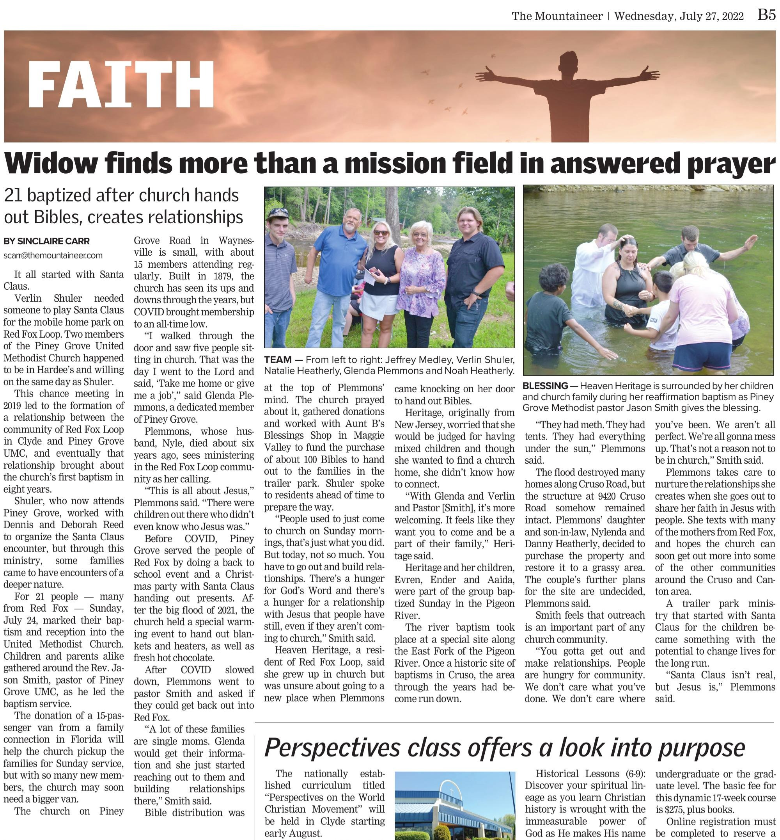
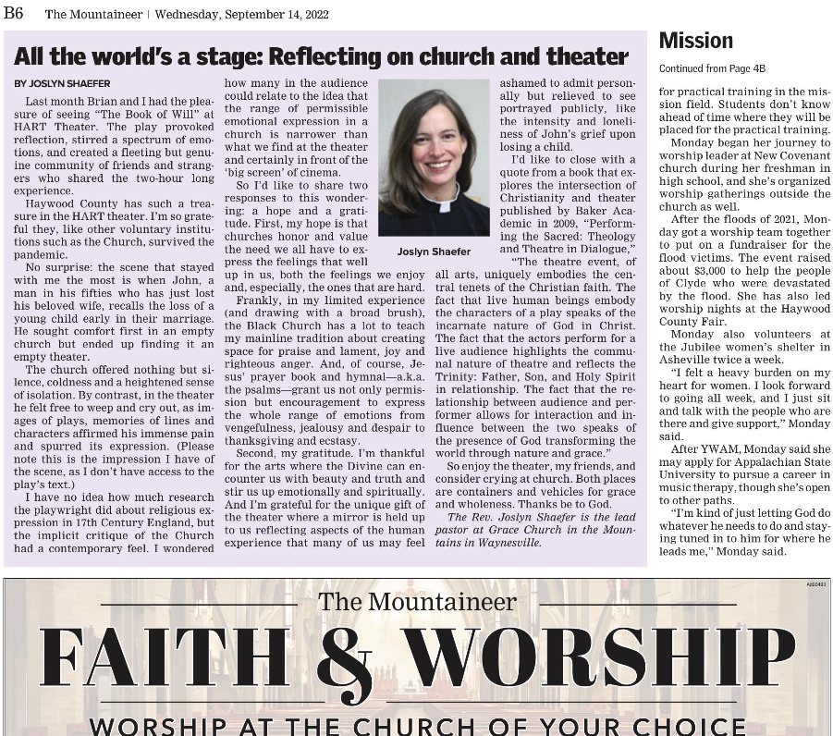
Feature
Priest Column
Notes:
Sinclaire is Rachel’s middle name, Sinclaire Carr=Rachel Carr.
Mrs. Glenda Plemmons story
When I was editor of the Mountaineer I received a call from one Glenda Plemmons, a member of Piney Grove United Methodist Church. She was very excited to tell me that they would be baptizing 21 people this Sunday. At first, I wasn’t interested. Don’t get me wrong, my soul was blessed to hear this good news, alas, people getting baptized isn’t news. The amount of people made it slightly interesting. But Mrs. Plemmons would not quit. After I gave her a noncommittal response at first, she texted me and emailed me until she was sure I had a full view of the story. It turns out those baptisms couldn’t have come at a better time. The church was struggling, attendance was down to five most weeks, and Mrs. Plemmons decided she would do something about it. So she started a trailer park ministry handing out Bibles and knocking on doors. If I’m being honest, I only covered the story because I love faith news and because she persisted. In the end, the story made a great feature because it had conflict and a resolution (bouncing back from low attendance).

Slide 12
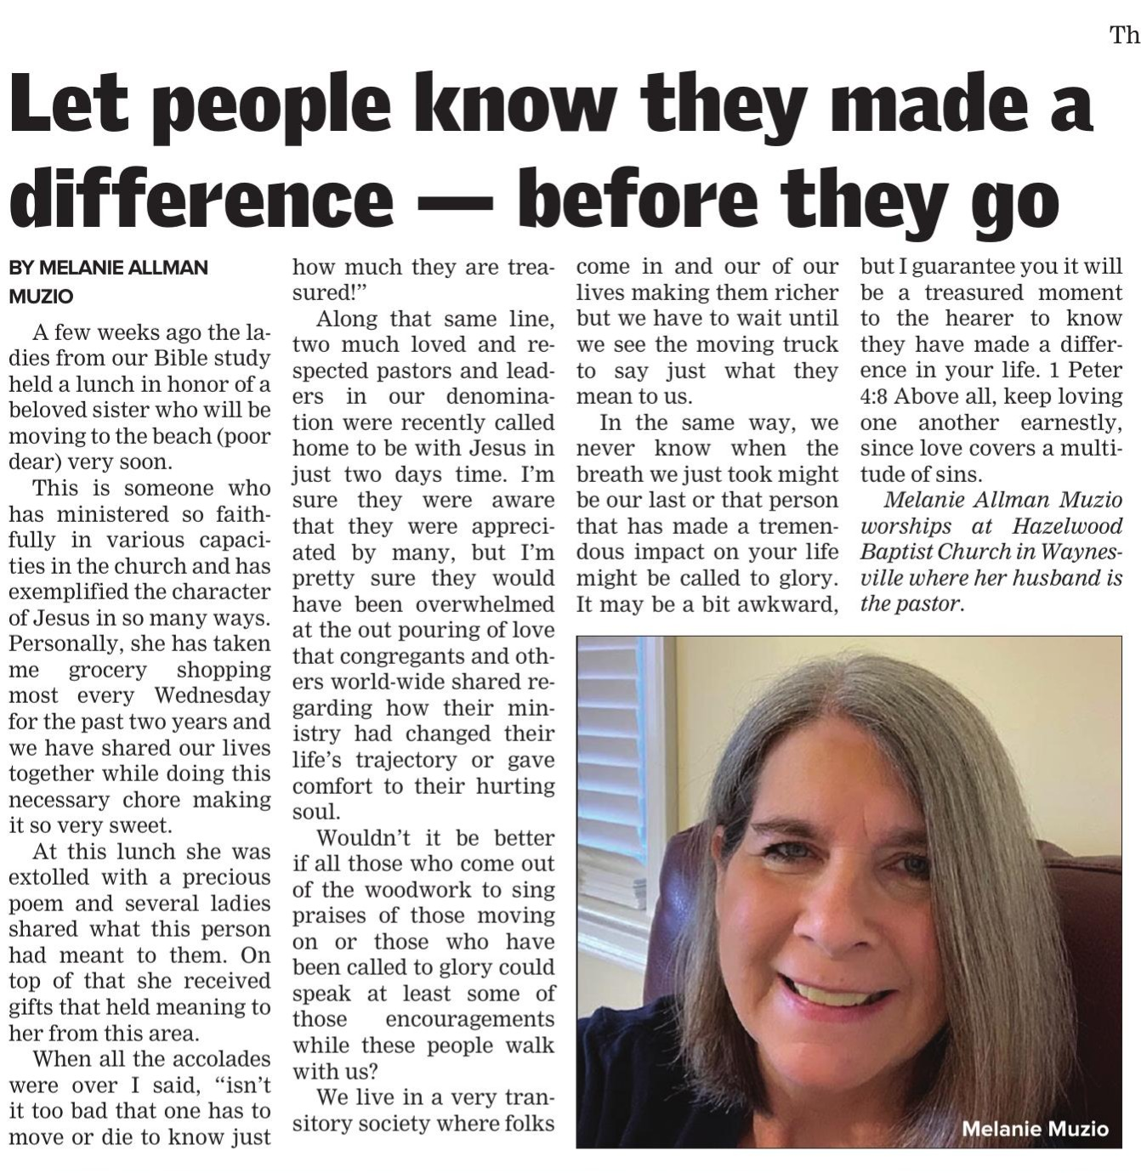
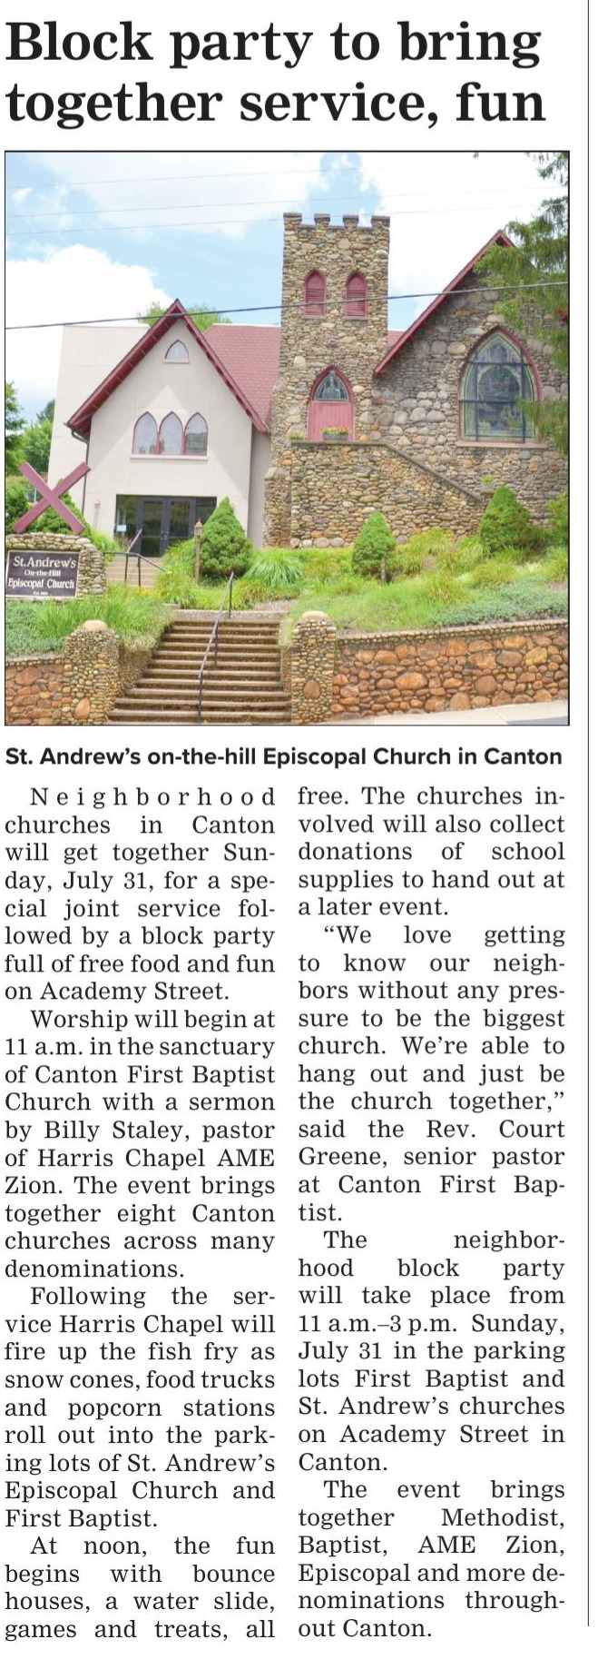
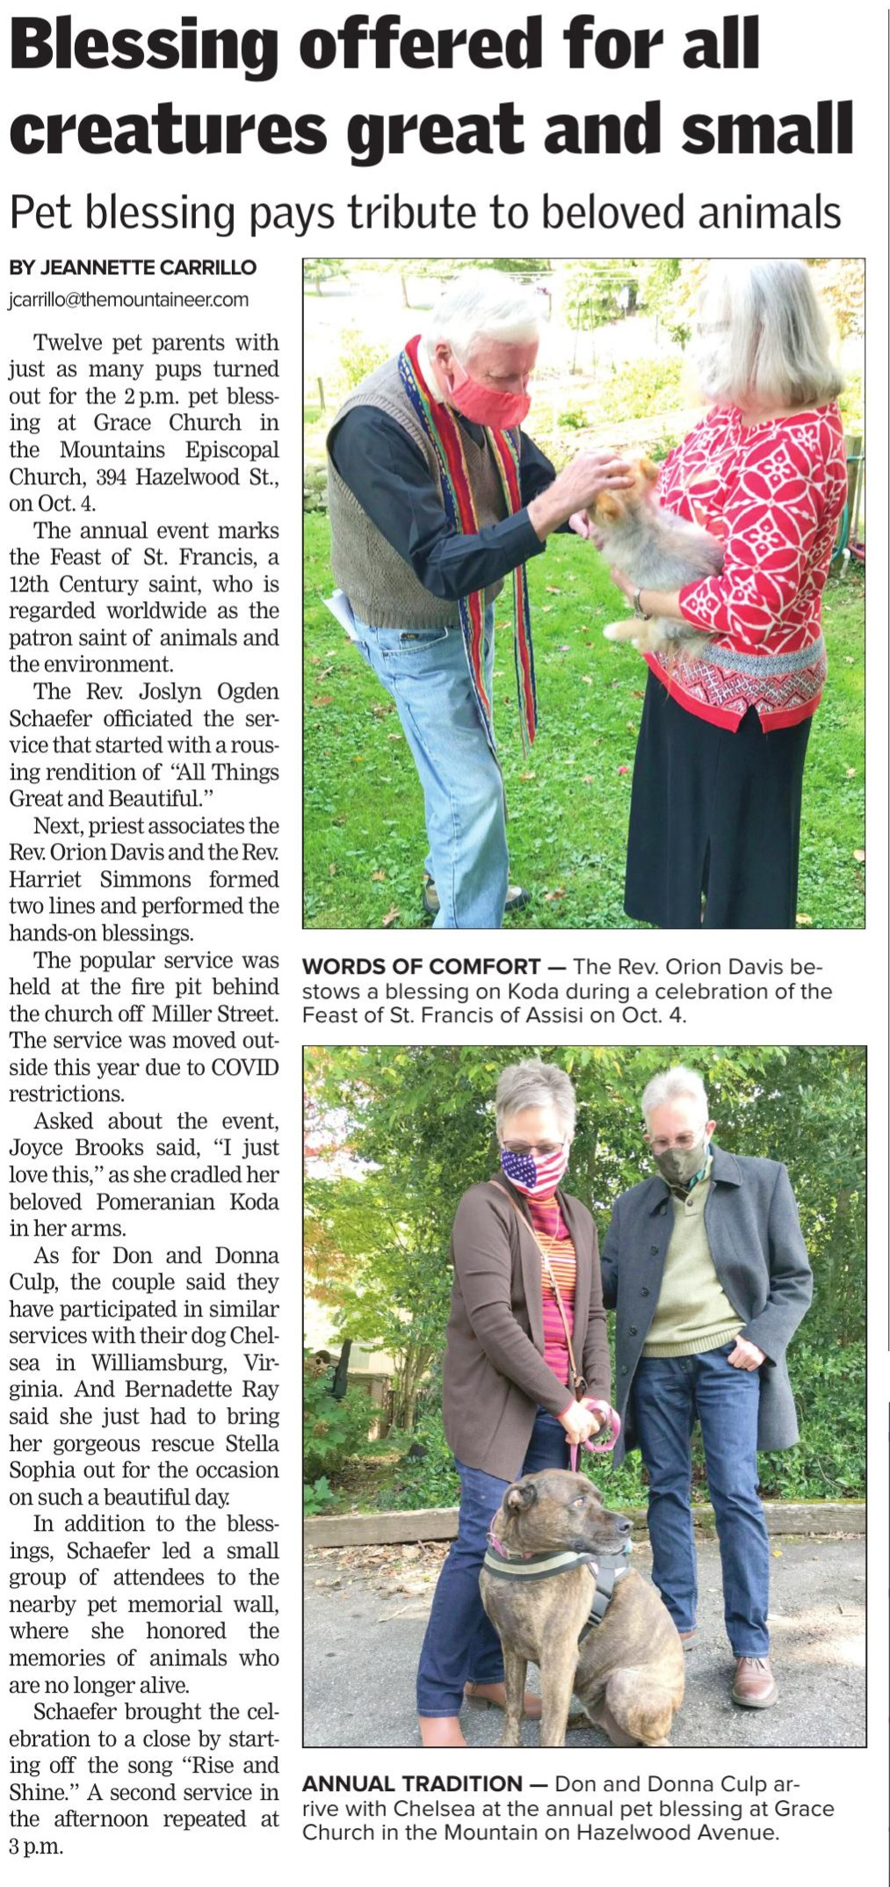
Event Announcement
Event coverage
Parishioner column

Slide 13
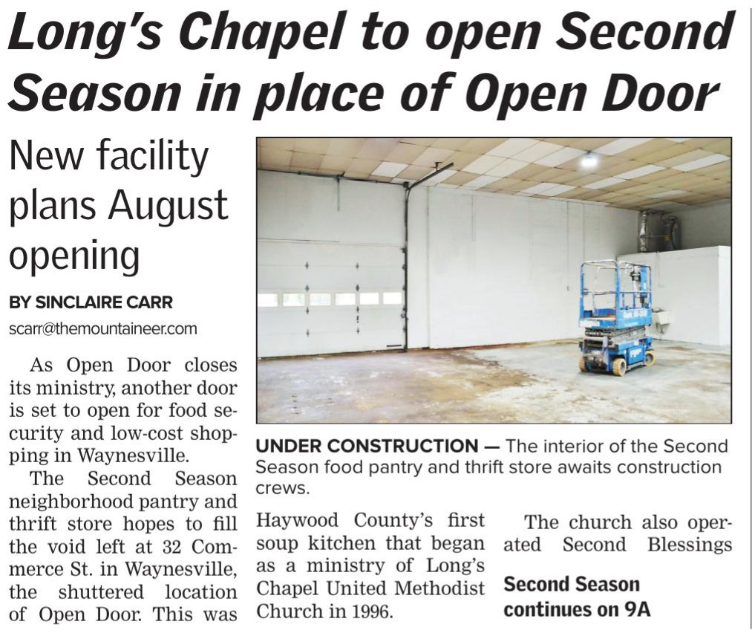
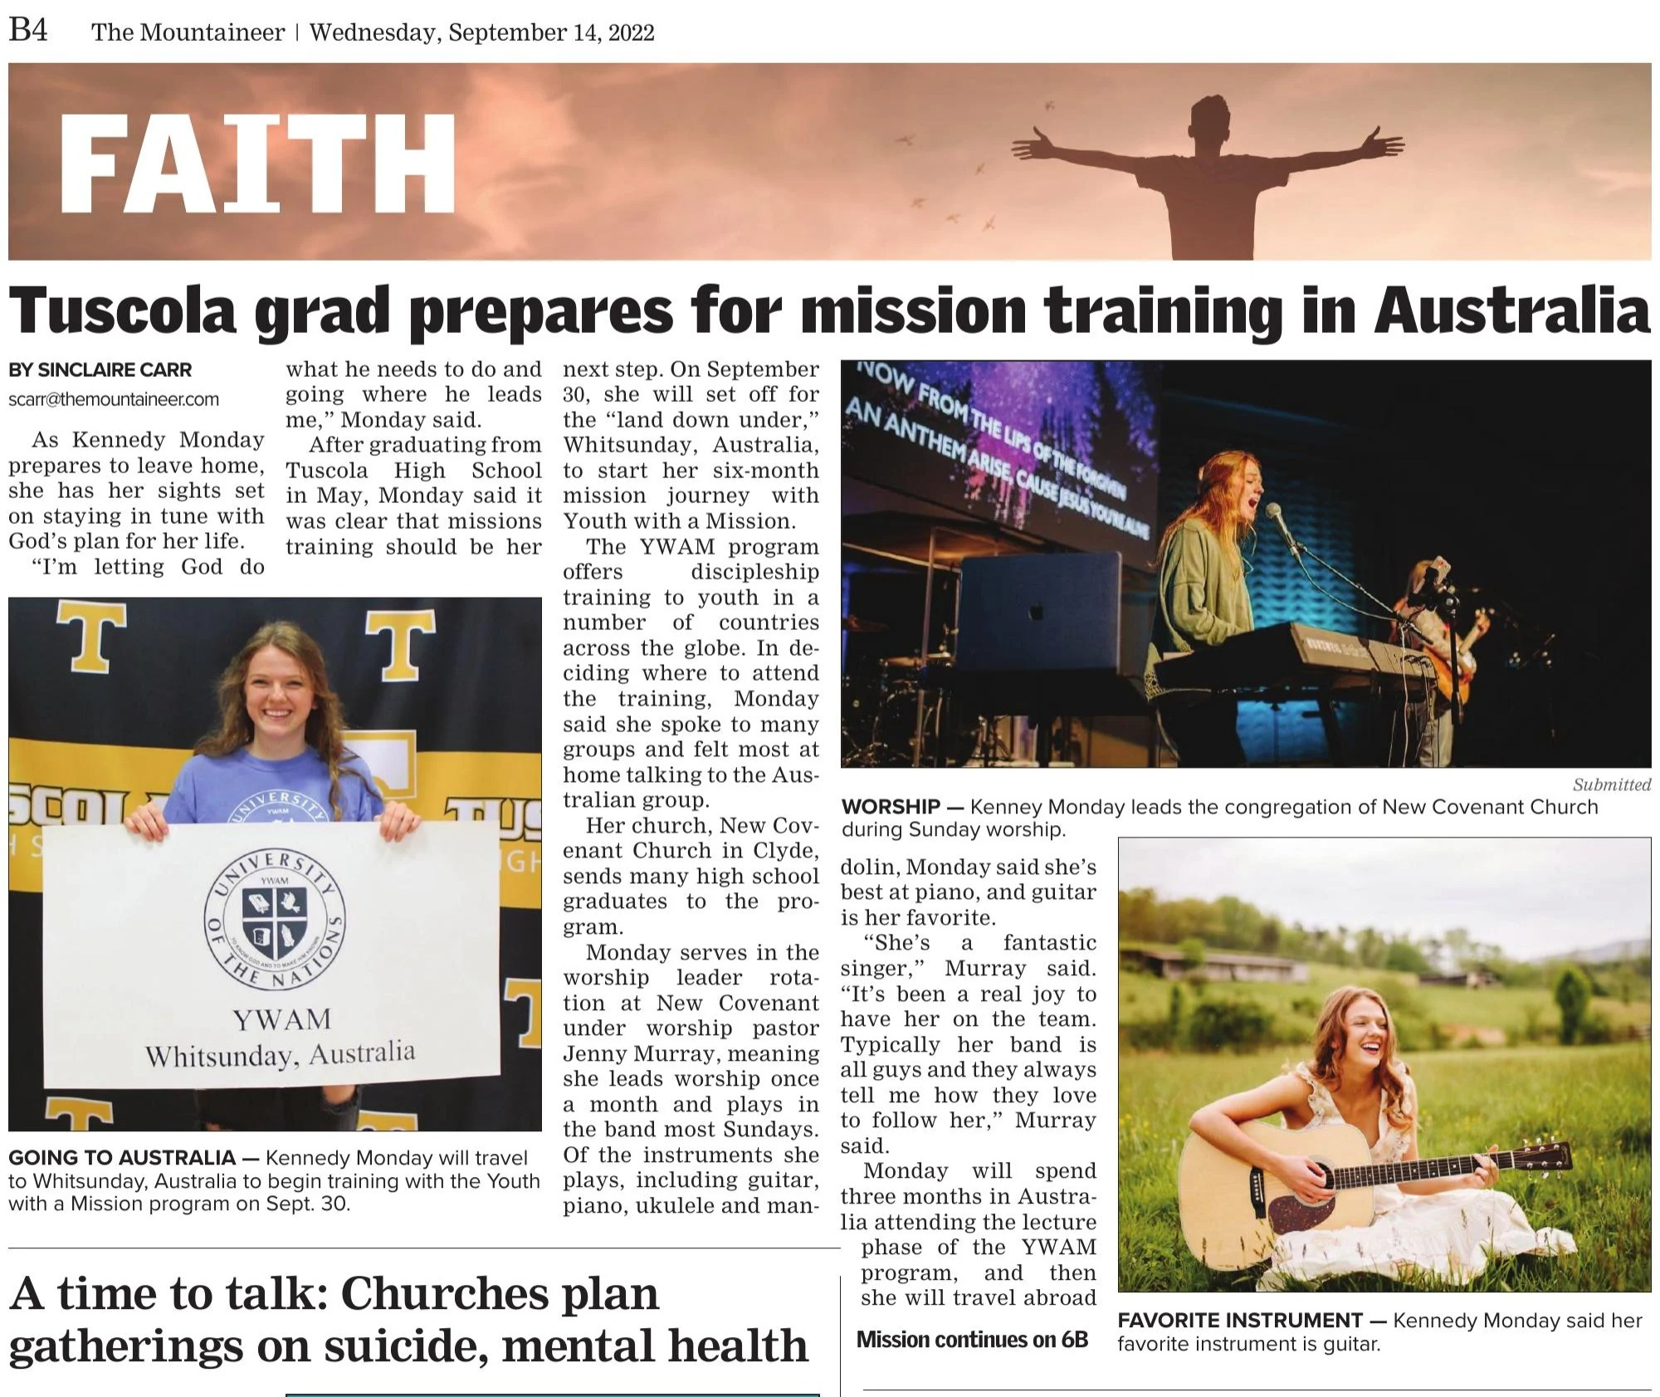
Front Page News Article
Feature

Slide 14
ACTIVITY TIME
Brainstorm some stories within your congregation. What are some things your community may be interested to hear about?

Slide 15
THE MODERN JOURNALIST
BUSY BUSY BUSY
Your typical journalist today juggles many obligations and will most likely appreciate content they don’t have to track down and write.
BE PERSISTENT!

Slide 16
STEP ONE: RESEARCH
Peruse the news outlet’s website to see what sections/segments they offer. Often, a reporter covers a certain subject (beat).
STEP TWO: APPROACH
Make a human connection. Introduce yourself. Call or drop by the newsroom, even ask to grab a coffee.
PROCESS
STEP THREE: SEND & SEND
Send the content they’re expecting. Watch for the story. If you don’t see it, send it to the reporter again. Be persistent!

Slide 17
SHARE THE STORY!
SAY THANK YOU
A small note of thanks can mean a lot to a reporter and help them remember you, so be sure to send one.
CELEBRATE GOOD COVERAGE
Send the story to the diocese (Rachel), your congregation, social media. Let it be seen by many.

Slide 18
CONTACT US
Episcopal Diocese of Western North Carolina
Review this series:
https://www.diocesewnc.org/communications-as-evangelism
Rachel Carr
David Henson
Diocesan Missioner for Communications
Rector, St. James, Hendersonville
rcarr@diocesewnc.org
david@stjamesepiscopal.com

