Slide 1
Communications as Evangelism
Communications as Evangelism
Being Present:
Being Present:
Websites and the Episcopal Asset Map
Websites and the Episcopal Asset Map
The Episcopal Diocese of Western North Carolina
Notes:
I’m not here today to convince you to get a website. Most of you, dare I say all of you, are present online in some way. But just like a person can physically sit in a room while being checked out mentally, so can your website be present online yet remain disengaged from the life of your church.
What I would like to do is share with you just how important it is to keep your website in the present and offer support and resources to make your website the best that it can be.

Slide 2
Why does a
website matter?
Why does a
website matter?
Creates presence
Increases Access
Offers credibility
Notes:
Someone give me one word as to why a website matters....?
Your website matters because it’s basically the virtual welcome mat of your church. It’s the most relevant first impression of your church community.
>Your website is an opportunity to show the world what your church or organization is all about. Think of your website as a story, a present journey that a visitor takes to learn about your history, what you stand for, and how they can get involved.
Personal invitation > website visit
Like the person in a room that is checked in mentally, your website can engage with others in a meaningful way.
>Today, if we have a question, we’re most likely going to search online for the answer. Access to your church/organization is severely limited if your website doesn’t offer the information people want to know. Think of it this way, if it’s missing online, it should be something you’re trying to keep secret.
>The other reason your website matters is because you gain credibility in the eyes of the community based on the quality of your website. It’s the difference between showing up for a job interview in sweatpants or showing up in a tailored suit.
That first impression should let the visitor come away with some idea of your values, and if they can't find service times quickly on Sunday morning, they may go back to bed.

Slide 3
What makes
a website
good?
What makes
a website
good?
Ease of navigation
Current information
Good visuals
Engaging layout/design
A link to the diocesan website
Notes:
Once someone visits your website, they'll click around for about 5-10 seconds to find what they need.
What are some things people might be looking for when visiting a church website?
Service times #1, then pastor, staff, and details about the church.
>Menus items should clearly say what they mean.
It’s great to be creative and cute, but don’t sacrifice clarity for cuteness when it comes to your menu items. If someone can’t navigate your menus, they’re leaving.
>Make sure your service times are updated and accurate. Make sure your staff page is accurate. Easter and Christmas high traffic.
>Keep your colors and fonts consistent across the website. Your pages may contain things with branding other than your own, but make sure you stay consistent with your titles, color, and fonts. Pictures!
>People stay on websites longer if they can click something. Add links to pages.
>And yes, please let people know you’re part of the diocese by adding a link to the diocesan website ☺

Slide 4
What should church websites include?
What should church websites include?
Home
Welcome
Service times
Quick links
About
Staff Page
History
Worship
Livestream link
What to Expect
Children/Youth
Serve
Ministries
Sign-ups
Connect
Events
Newsletter
Contact
Give
(Other)
Learning
Notes:
These are examples of common menu items.
The most prominent information should be your service times! Put that on the homepage, accessible within 5 seconds.
Homepage: value statement, service times
About/Worship: Let people see who you are. It’s a great place for your staff page and to tell a bit about the history your church, service details, etc.
Including a What to Expect page can be great for people who are new to the Episcopal Church.
A lot of people leaving more Evangelical spaces are interested in TEC, but they may be unfamiliar with our liturgy, so offer a bit of guidance.
People also want to know where their children are expected to be. Even if you don't have any children's services, mention that they're welcome in with adults.
Serve: Offer information about your outreaches, say to contact the rector@ email for more information, even if you have a dedicated volunteer.
Connect: Best place for newsletter sign ups, an events calendar, and contact information. A page for contact is sufficient, and include sign up link there.
Give: Allow people to give online, very helpful to have in your top menu so easy to find.

Slide 5
All Saints - Chicago
Examples of Good
Websites
Examples of Good
Websites
St. Margaret's - D.C.
Calvary+St. George's - New York

Slide 6
Activity Time!
Activity Time!
Solo (7 mins) -
Pull up your church website.
Sketch new homepage and menus.
Group (10 mins) -
How do you use your site?
What might you change?

Slide 7
What does a
website cost?
What does a
website cost?
Hosting and Domain
Separate cost
Hire a Web Designer
$30–$100/hour
Flat rate $2,000+
Website Builder Plans
Average $200/year
DIY Design
Hosting+Domain included
More Info: Article Link
Notes:
Know your website domain registrar (GoDaddy, Network Solutions, Google, Hover, etc.)
Keep account login info accessible (You may LOSE ACCESS to your domain if not!)
For example, you setup your website through Wix, but you registered your domain through Hover. This is good because if you somehow lose access to Wix you can still access your domain registration and keep the payment information up to date. And vice versa. The best way is to make your email a general email (such as admin@church.org) that will be accessible even if the entire staff of your church changes.
Web Designer, Can be hired for a redesign. Freelancers vary.
Builder plans – Wix, Weebly, SquareSpace, include Graphical User Interface to drag and drop design.

Slide 8
Getting help
with website costs
Getting help
with website costs
Congregational Vitality Grant
Can cover cost of hiring designer/redesign
Plan fees/hosting/domain not covered

Slide 9
Let's Discuss
Let's Discuss
Aha! moments?
Questions?

Slide 10
Understanding The Episcopal Asset Map
A window into our diocese and denomination

Slide 11
About the map
A way to explore ministries, churches, and Episcopal communities.
A way to share your church info and your congregation's stories.
A way for TEC to find connections across similar areas of ministry.
Notes:
Service of Episcopal Relief and Development.
A welcome mat for your website.
Folks at national Episcopal Church use the map to find out about international relationships, such as digging a well over seas. Same thing for disaster preparedness.

Slide 12
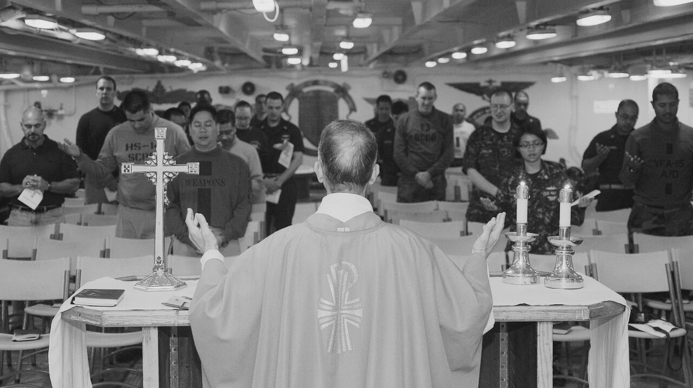
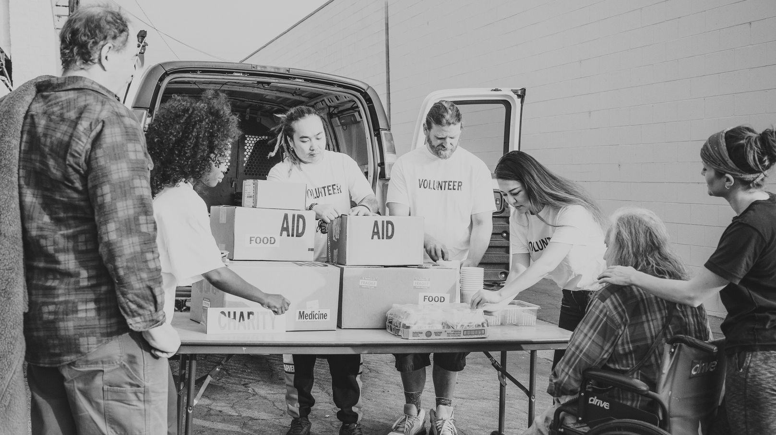
Let’s look at the map

Slide 13
Make the most of the map
What should be present on a church's page?
Stories
Church Info
Ministries
Elaborate on how your church participates in the Jesus Movement by sharing articles and videos. The map shows off your style and community life.
Be sure to update your service times, rector, and church contact info.
The map is a welcome mat for your website.
Add local initiatives, international partnerships, disaster preparedness relationships. The map helps the larger church connect.
Notes:
Submit your changes, Diocesan account holder (Rachel for WNC) will approve changes. The changes will not appear immediately.

